Slide 1

Airline Baggage Complaints Analysis
Author: Sonam Rathod
Date: November 22, 2024

Slide 2
How Baggage Complaints Forecasts Help
Improved Resource Allocation:
Equipment Readiness: Predicting busy periods allows airlines to service and allocate necessary equipment, like conveyor belts and baggage carts, in advance.
Proactive Communication: Knowing when complaints are likely to rise enables airlines to communicate potential delays or issues to passengers, reducing frustration.
Quick Issue Resolution: Airlines can deploy additional customer service representatives during predicted high-complaint months to address issues swiftly.
Strategic Planning:
Policy Adjustments: Airlines can refine their baggage policies, such as weight limits or processes for lost baggage, based on forecasted complaint trends.
Operational Improvements: Data-driven insights highlight areas for improvement in baggage systems to reduce recurring complaints over time.
Competitive Advantage:
Building Trust: Consistent handling of baggage issues, based on predictive insights, strengthens customer trust and loyalty.
Industry Positioning: Airlines that actively address complaints can differentiate themselves in a competitive market.
Reducing complaints can lower operational costs associated with complaint processing, compensation, and claims for lost or damaged baggage.
Regulatory Compliance:
Airlines can meet or exceed industry standards and regulations for baggage handling, minimizing penalties or reputation risks associated with poor service.
Staffing: Forecasts help airlines ensure sufficient staffing in baggage handling during high-complaint months, such as holiday or peak travel seasons.
Enhancing Customer Experience:
Cost Management:

Slide 3

Dataset Overview
Monthly data for three airlines: United, American Eagle, and Hawaiian.
Airline: Name of the airline.
Date: Reporting date (monthly).
Baggage: Count of baggage complaints
Scheduled: Number of scheduled flights
Cancelled: Number of canceled flights
Enplaned: Number of passengers enplaned

Slide 4
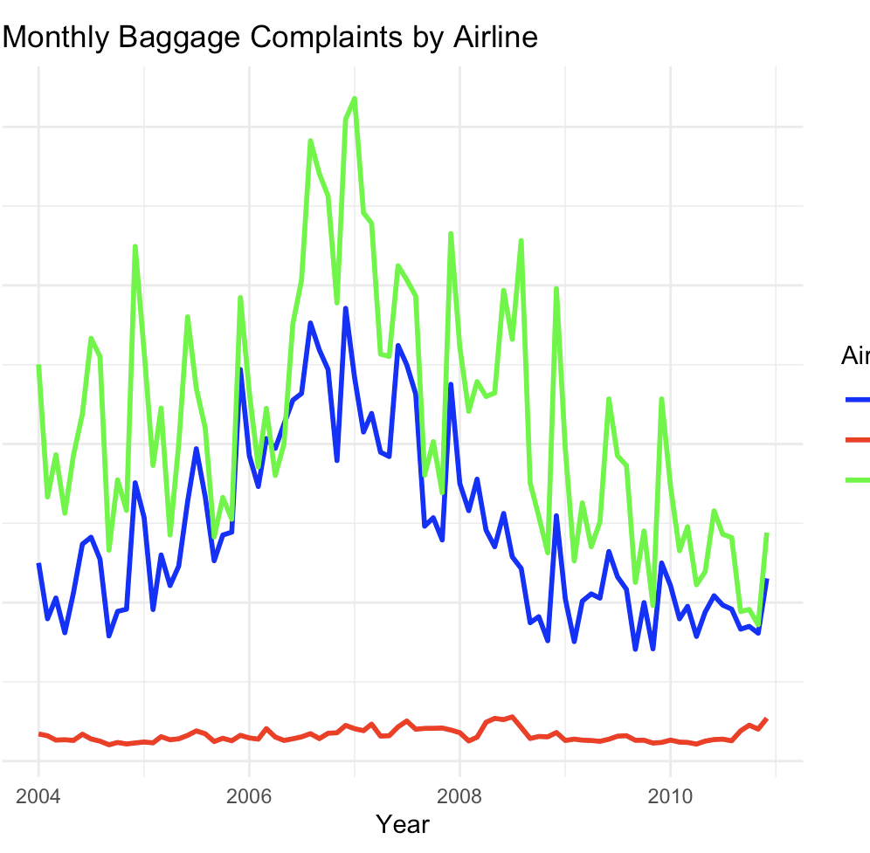
Exploratory Data Analysis
United Airline - Most Complaints
American Eagle Airline - Moderate Complaints
Hawaiian Airline - Lowest Complaints

Slide 5
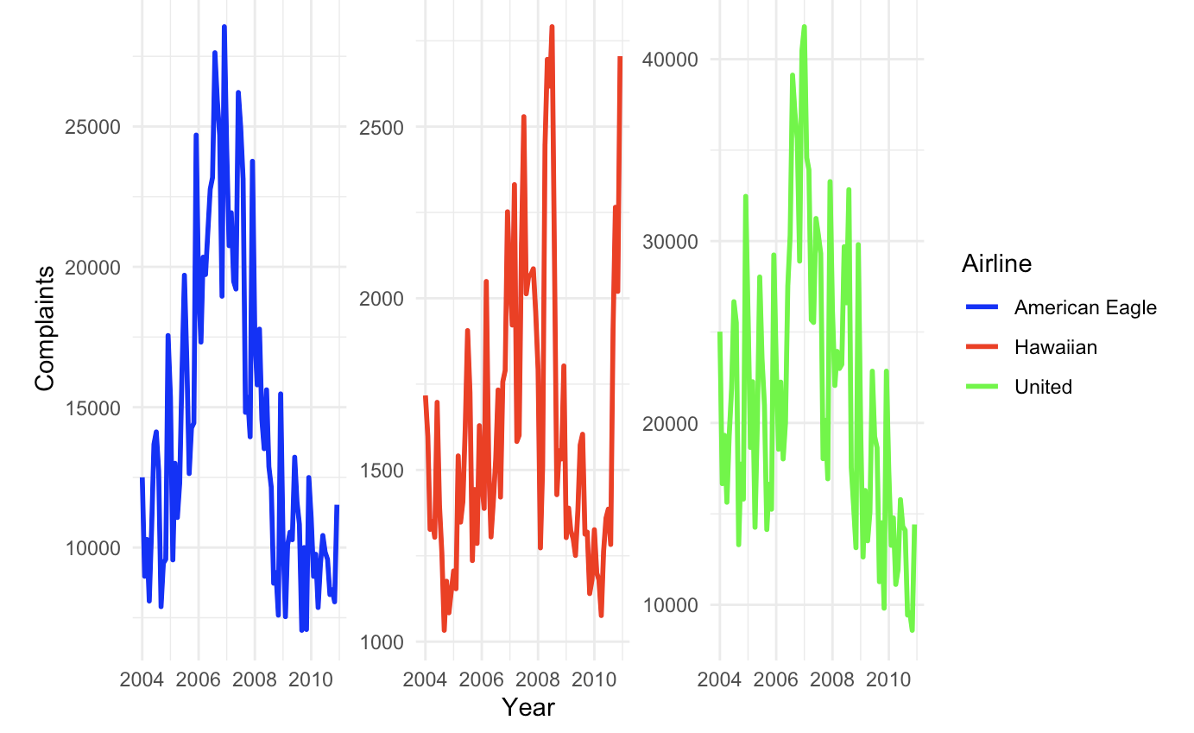

Slide 6
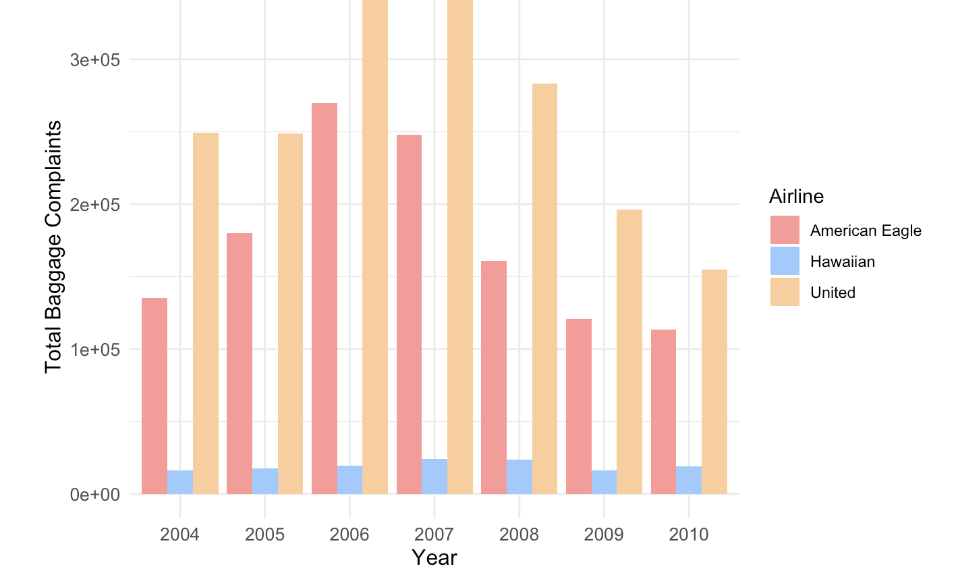

Slide 7
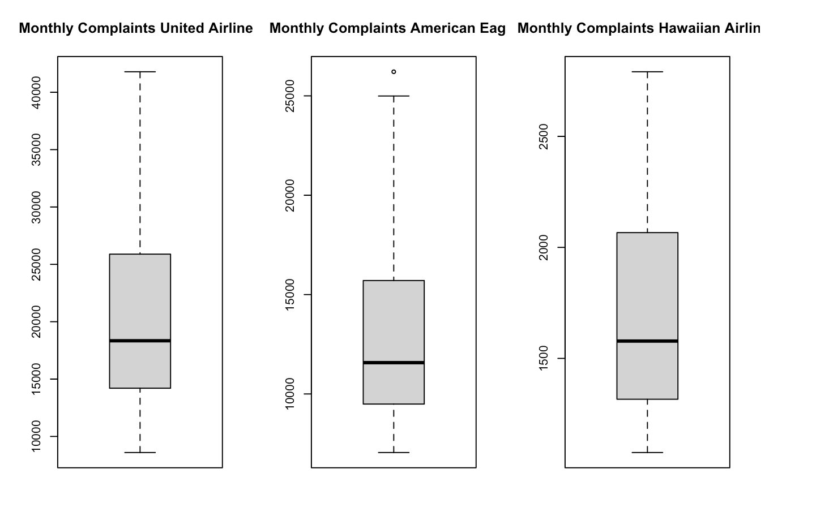

Slide 8
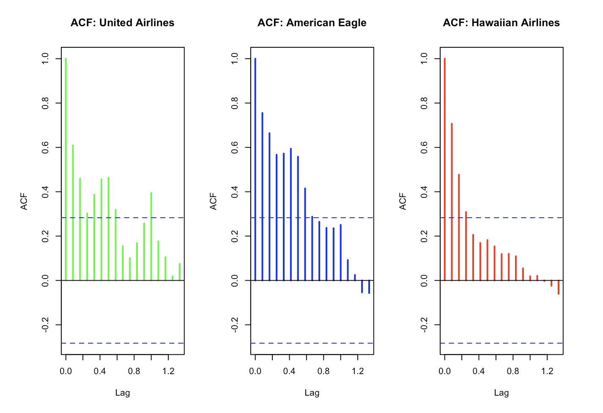
United Airlines
Both seasonality and trend are significant factors. Complaints tend to increase during specific seasons and persist for multiple months.
American Eagle
Shows weaker seasonality and trend compared to United. Complaints might still rise slightly during peak travel periods but don’t persist long.
Hawaiian Airlines
No seasonal influence or trend is visible. Complaints remain stable and consistent across all months.
United
American Eagle
Hawaiian

Slide 9
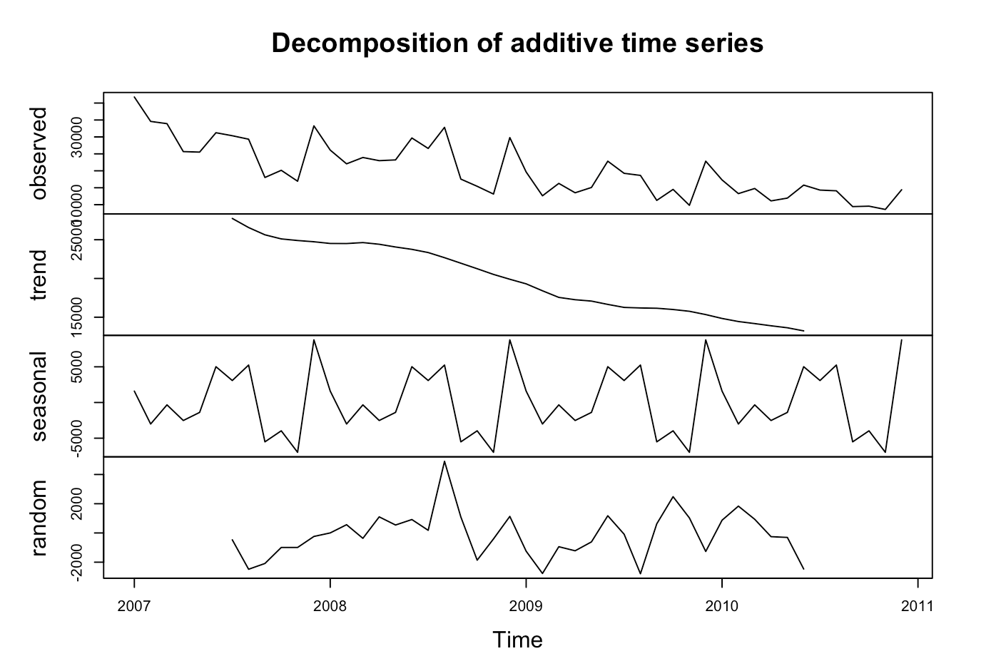
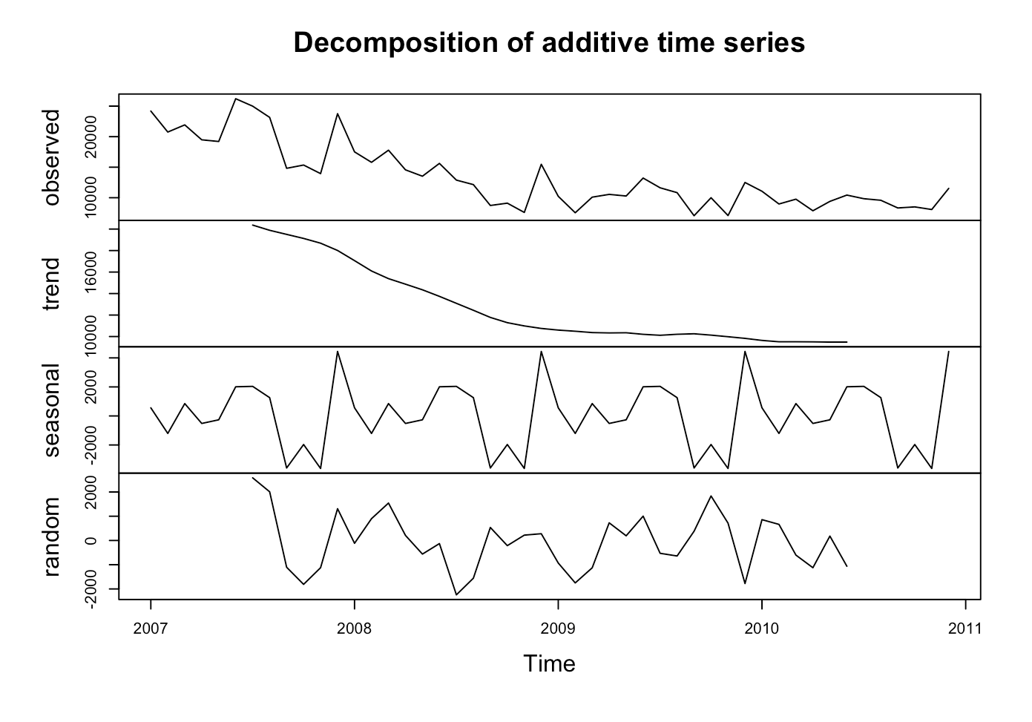
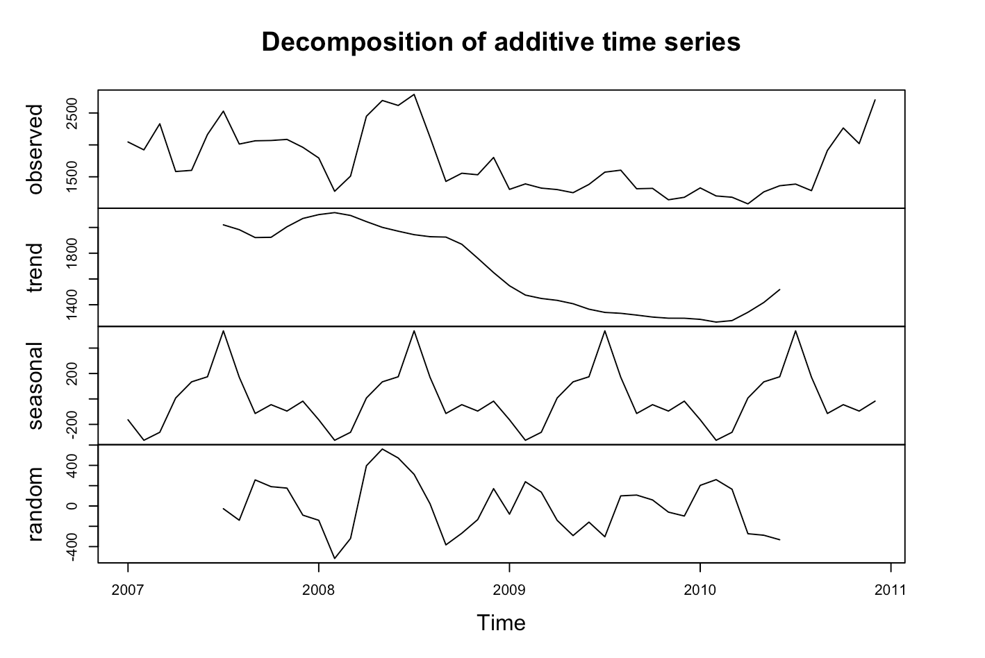
DECOMPOSITION
United Airlines
American Eagle
Hawaiian
- United Airlines has a clear seasonal pattern with a long-term downward trend, indicating gradual improvement over time.
- American Eagle shows a declining trend with weaker seasonal patterns.
- Hawaiian Airlines shows minimal seasonal effects and no significant trend, reflecting a stable and well-managed baggage handling system.

Slide 10
Accuracy Measure
Mean Absolute Percentage Error (MAPE)
Measures accuracy as a percentage of the actual values.
Intuitive for stakeholders to understand.
Suitable for comparing models across airlines.

Slide 11
Forecasting Methods

Slide 12
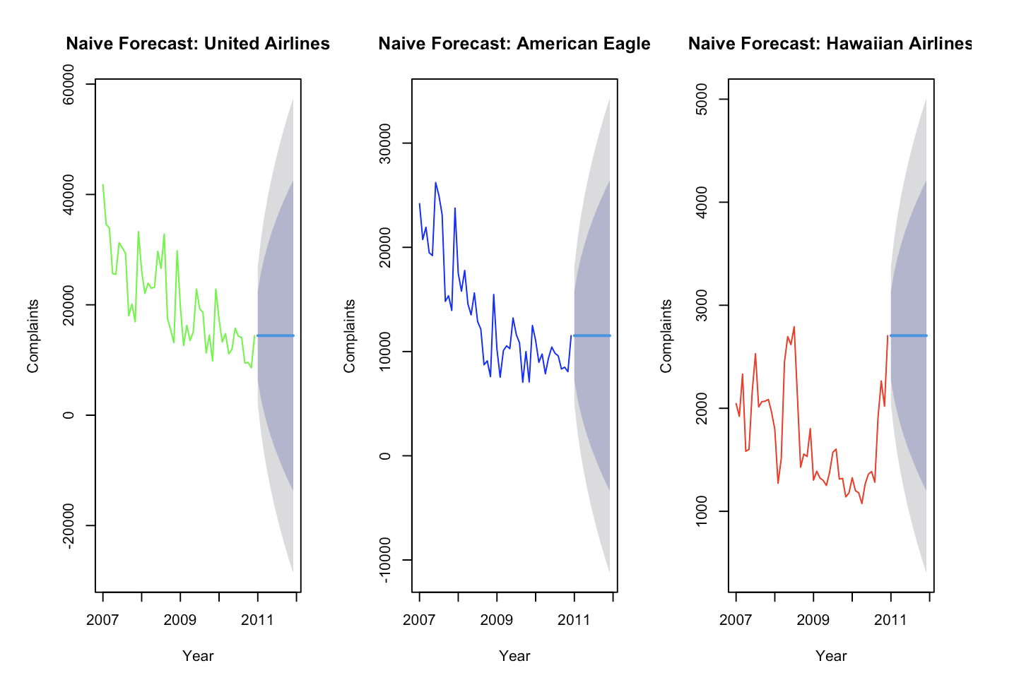
NAÏVE Model

Slide 13
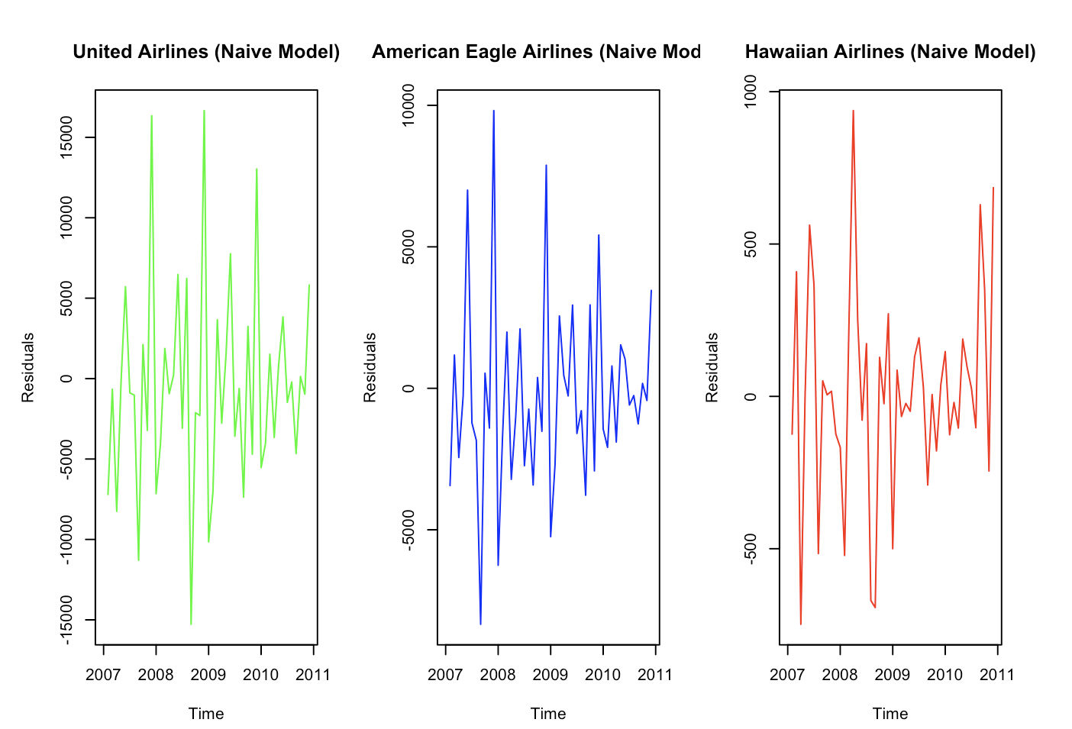
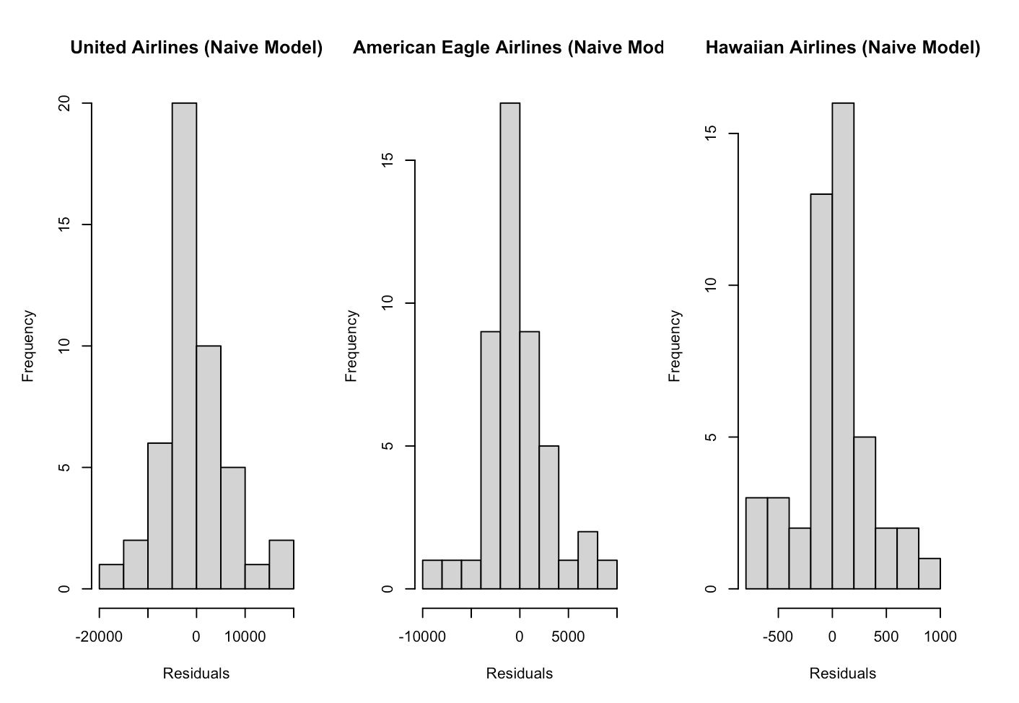
RESIDUAL ANALYSIS

Slide 14
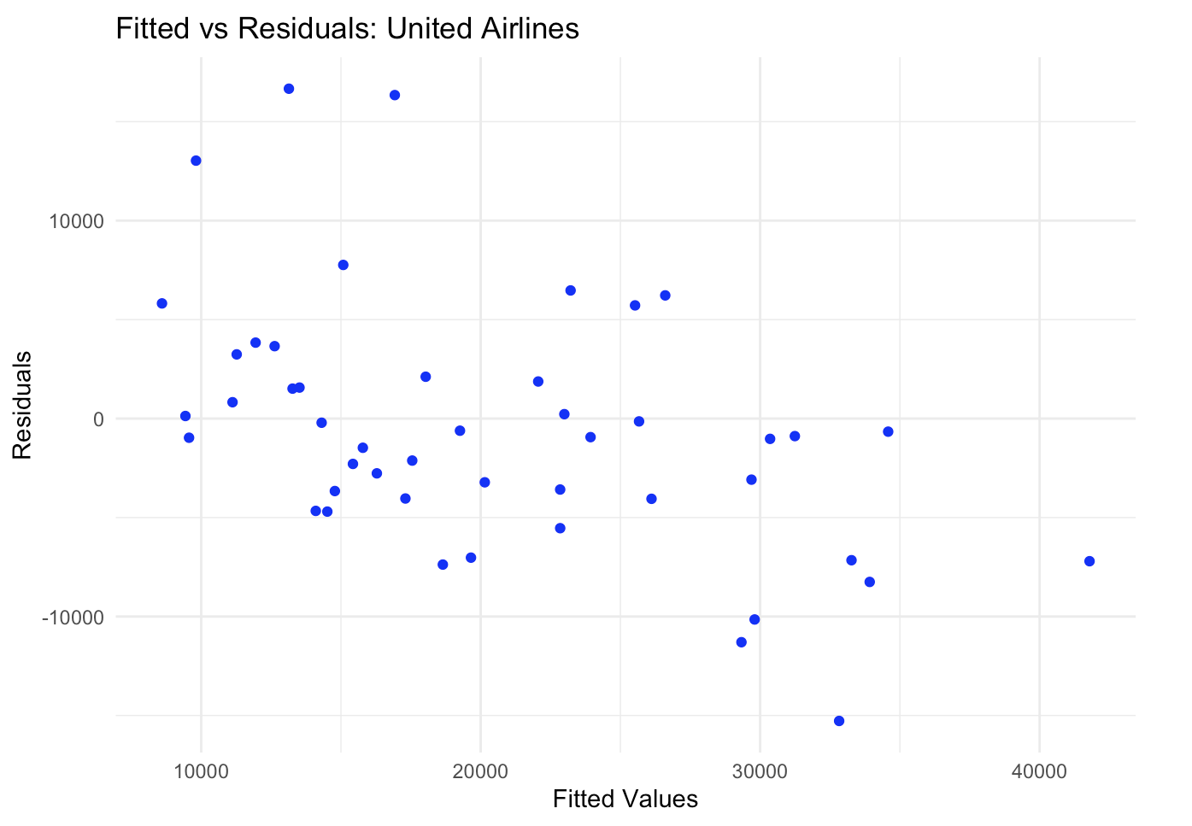
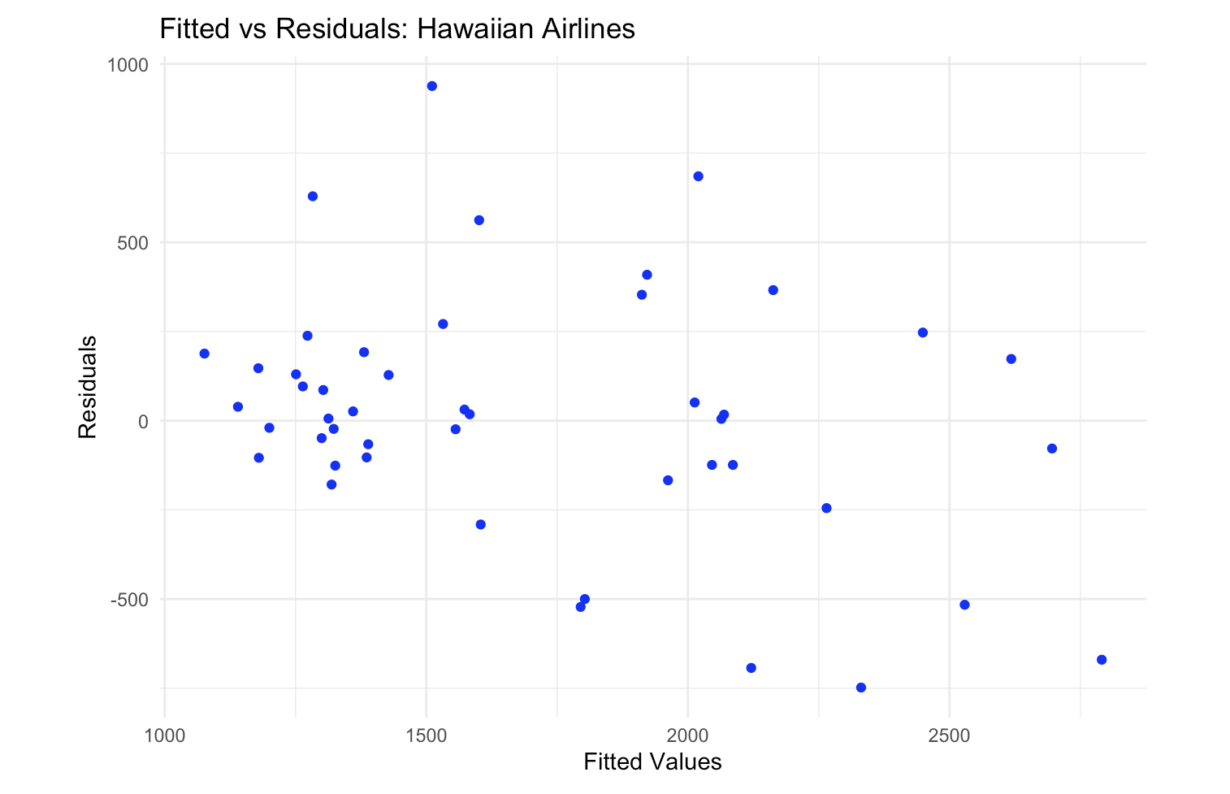
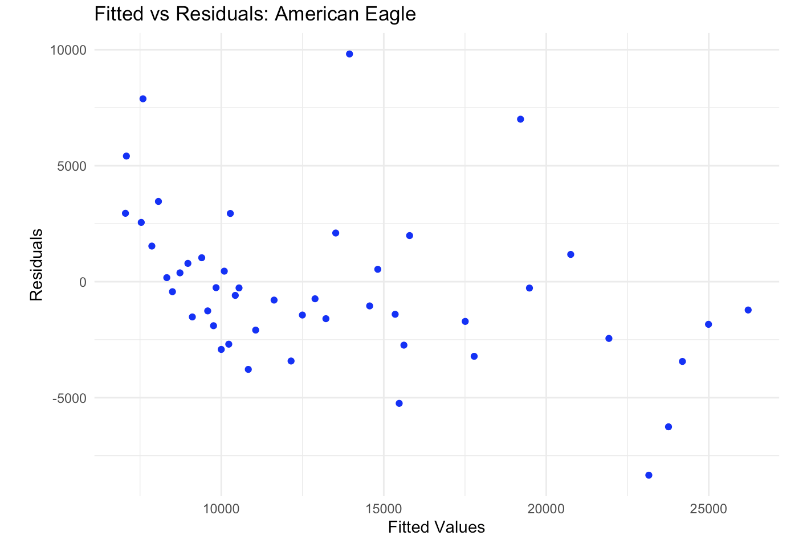

Slide 15
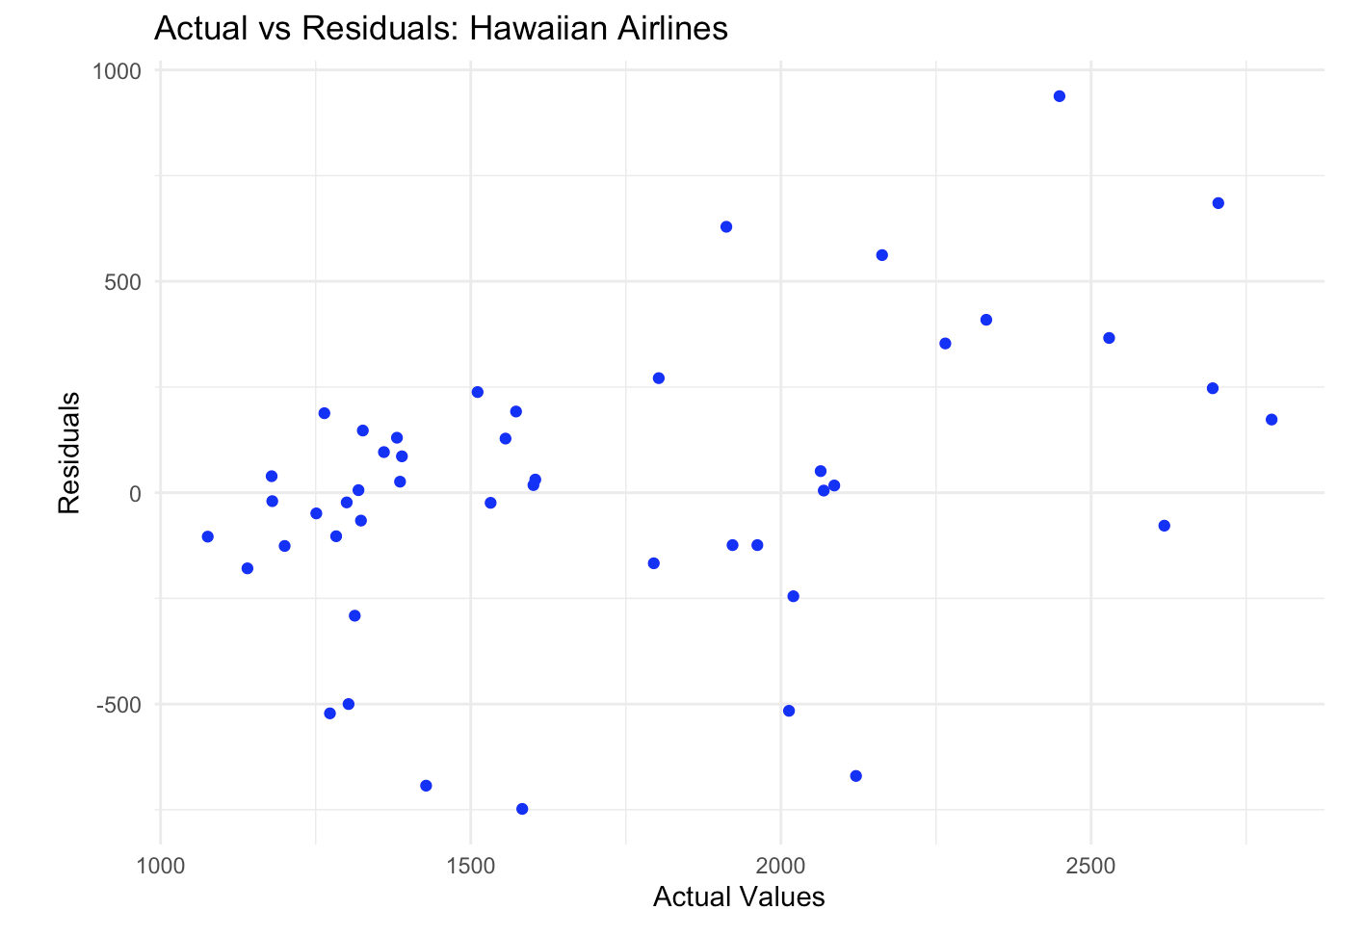
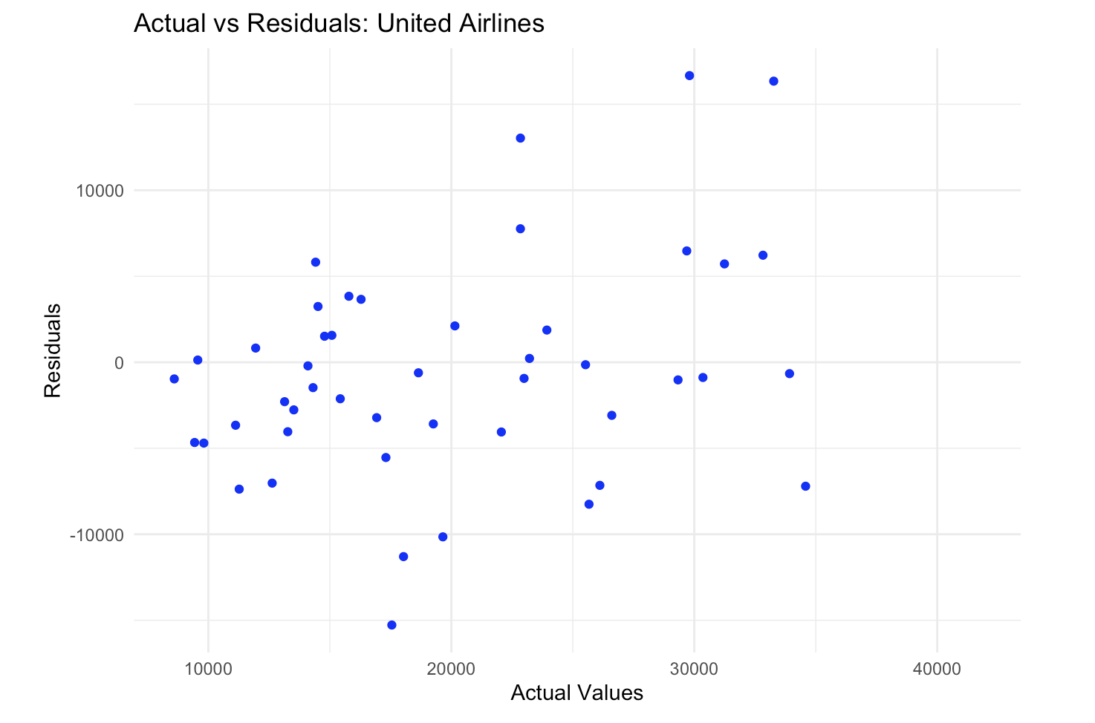
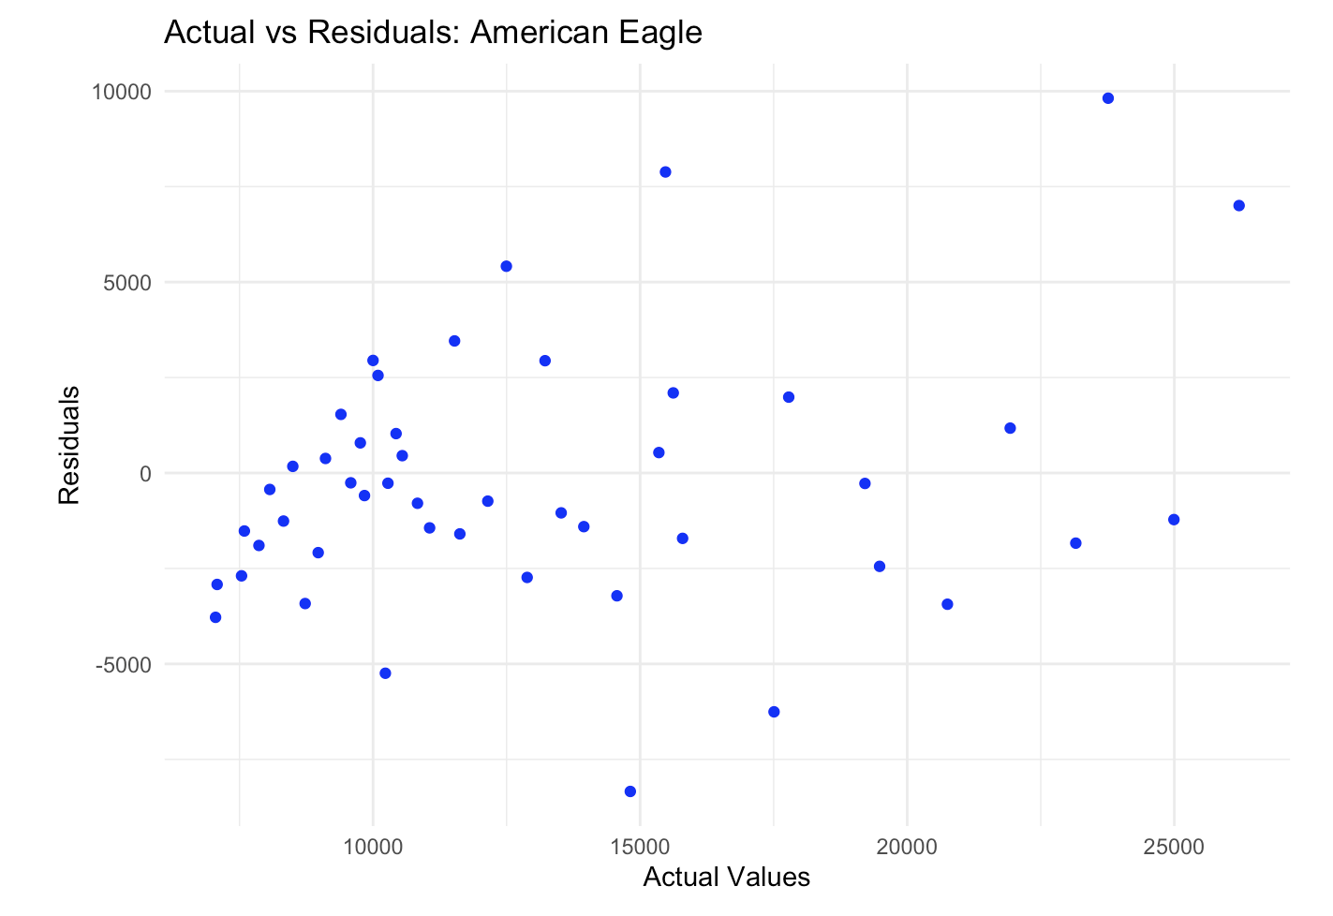

Slide 16
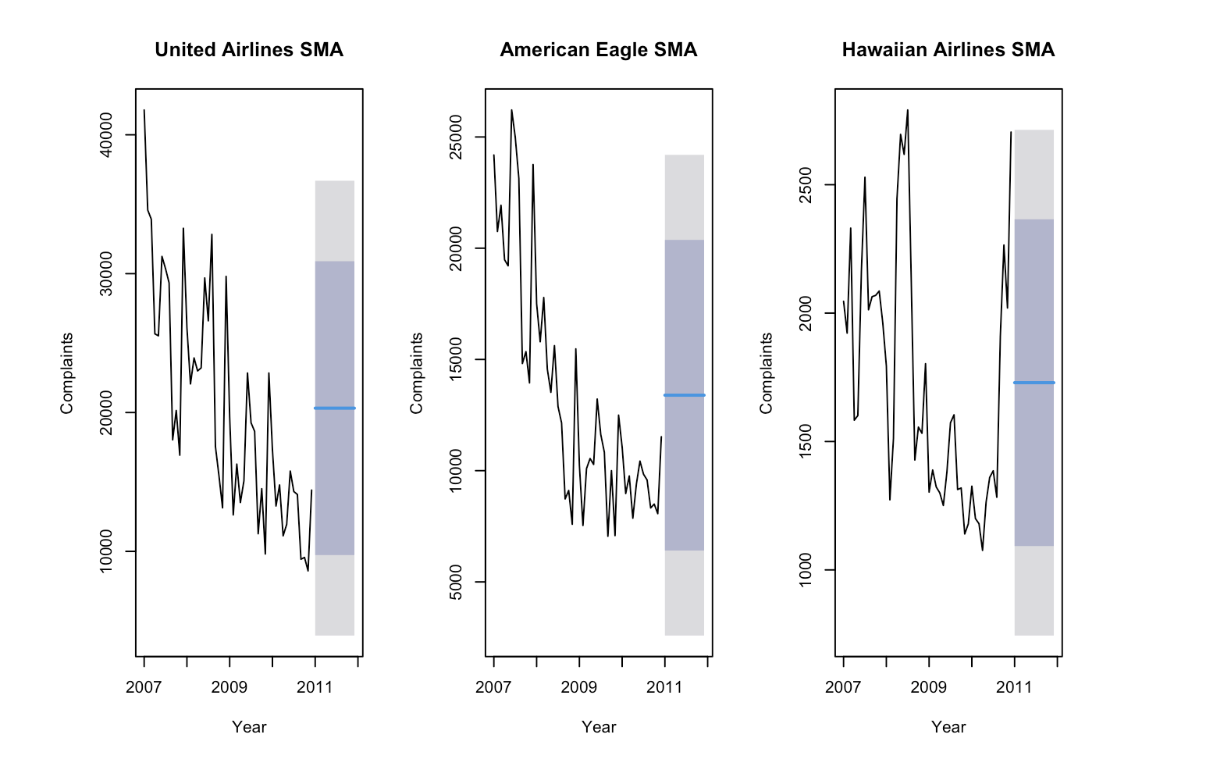
SIMPLE MOVING Average

Slide 17
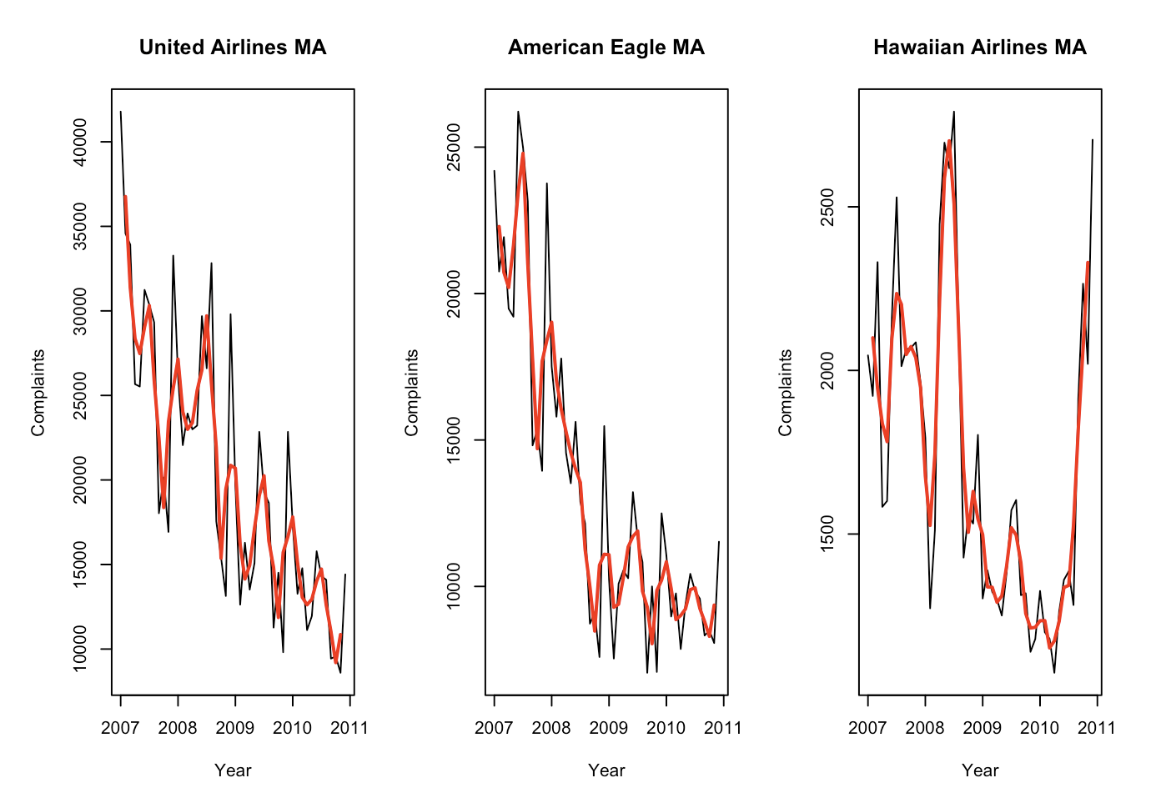
Moving Average

Slide 18
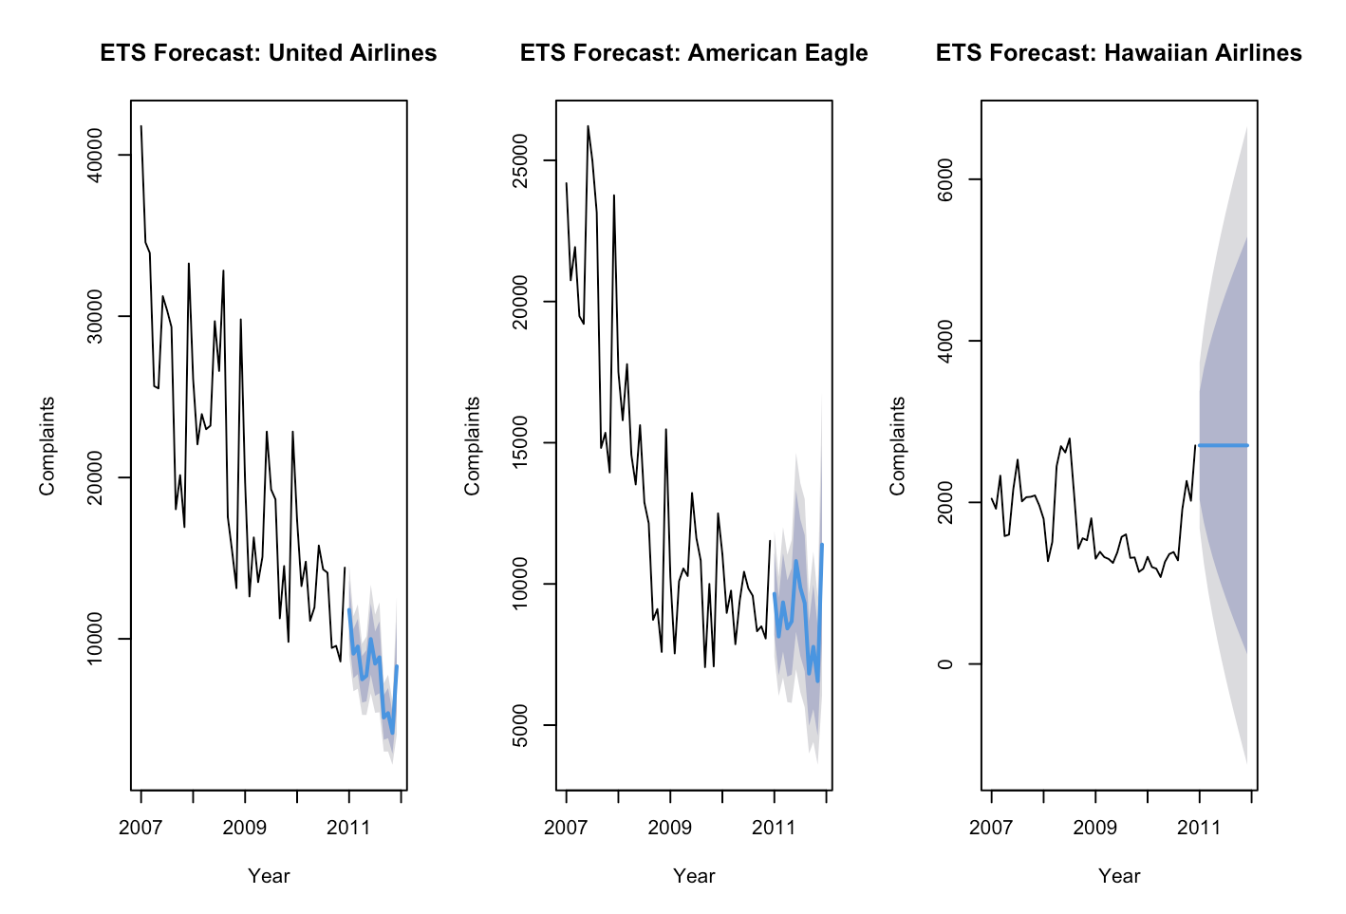
ETS

Slide 19
Model Summary
United Airlines
Alpha = 0.3861, The model gives some weight to recent complaints but also considers historical data.
Beta = 0.0001, very low, slow change in trend
Gamma = 0.0002 very low, seasonal patterns are stable.
American Eagle
Aplha = 0.5059, the model reacts more quickly to changes in the level.
Beta = 0.0001, very low, slow change in trend
Gamma = 0.0001, Very low. Seasonal patterns remain stable over time.
Hawaiian Airlines
Alpha = 0.9999, Strong reliance on the most recent data, there is no trend or seasonality.

Slide 20
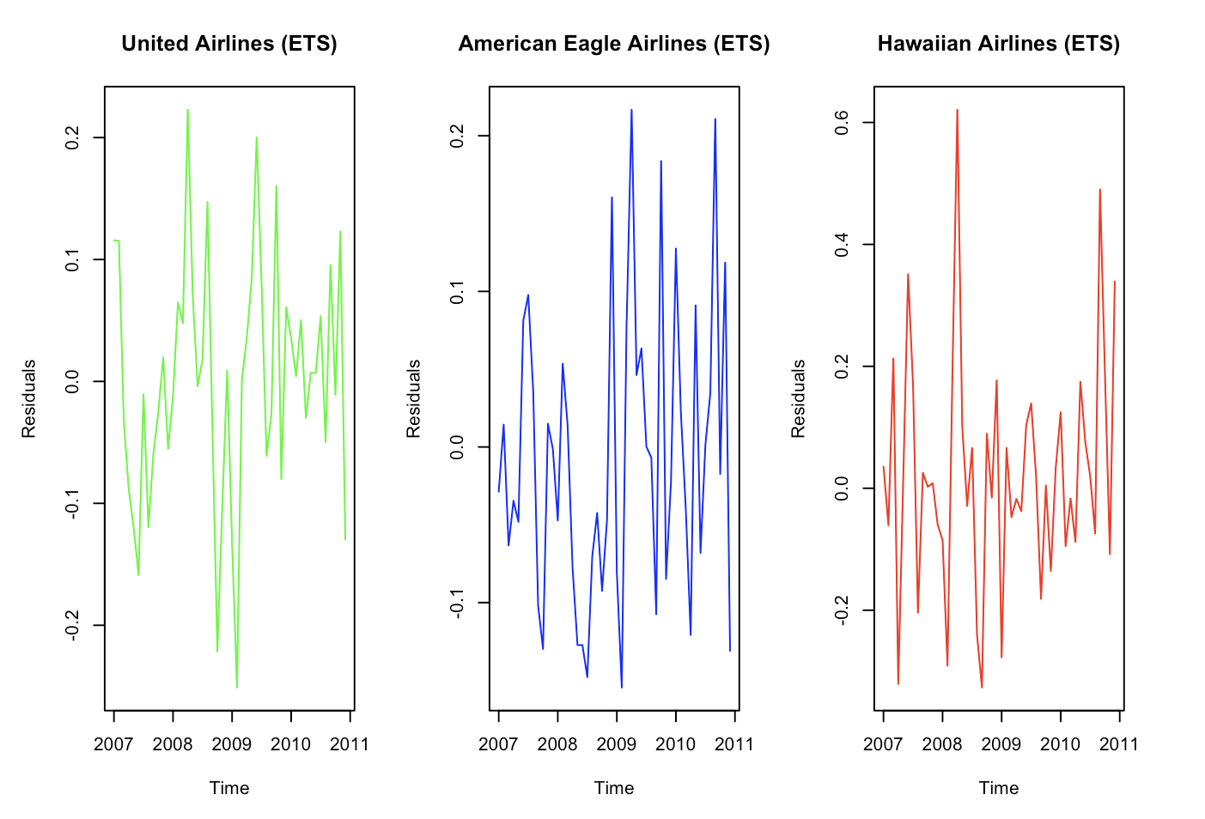
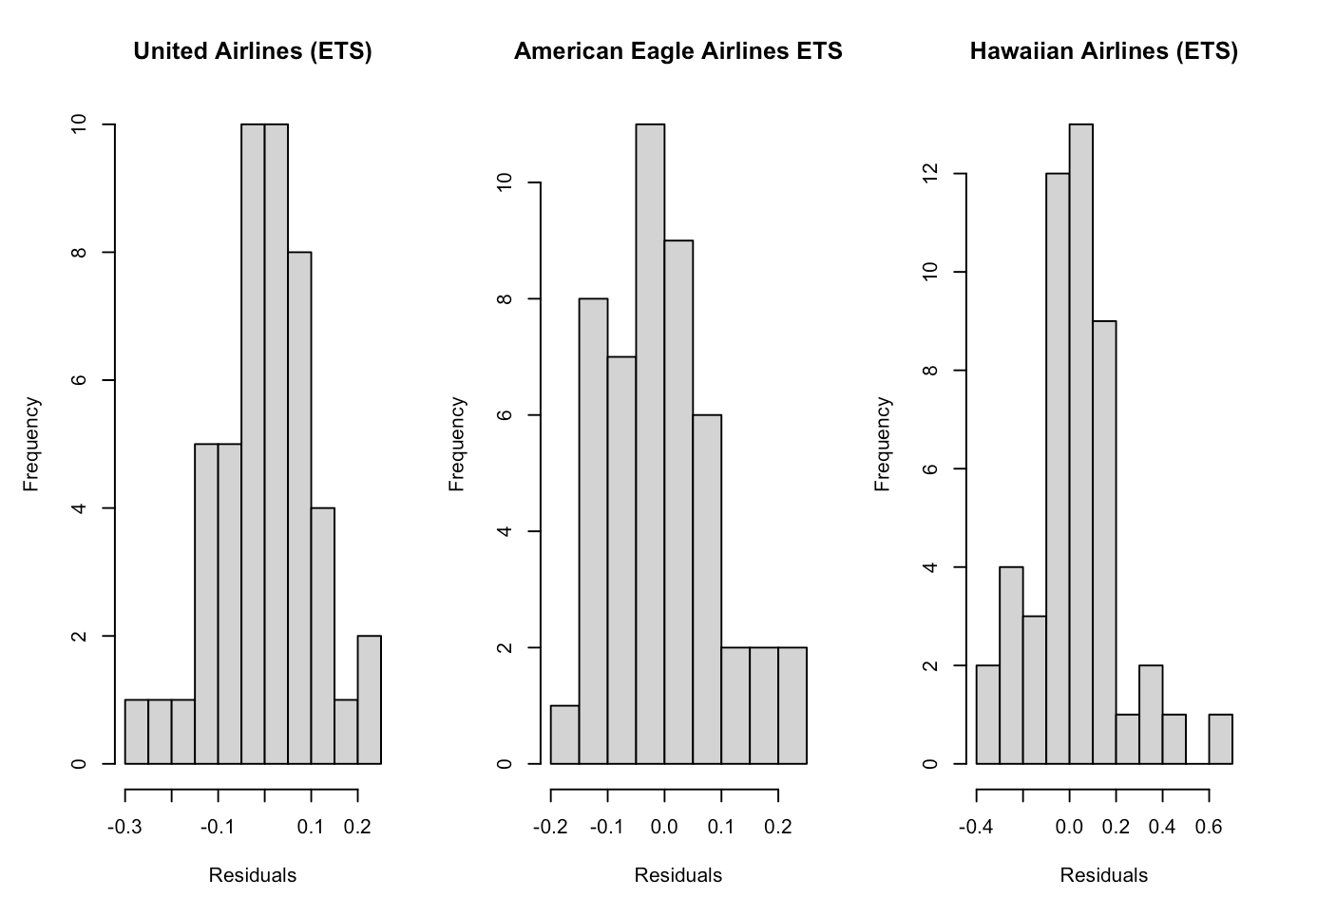
Residual Analysis

Slide 21
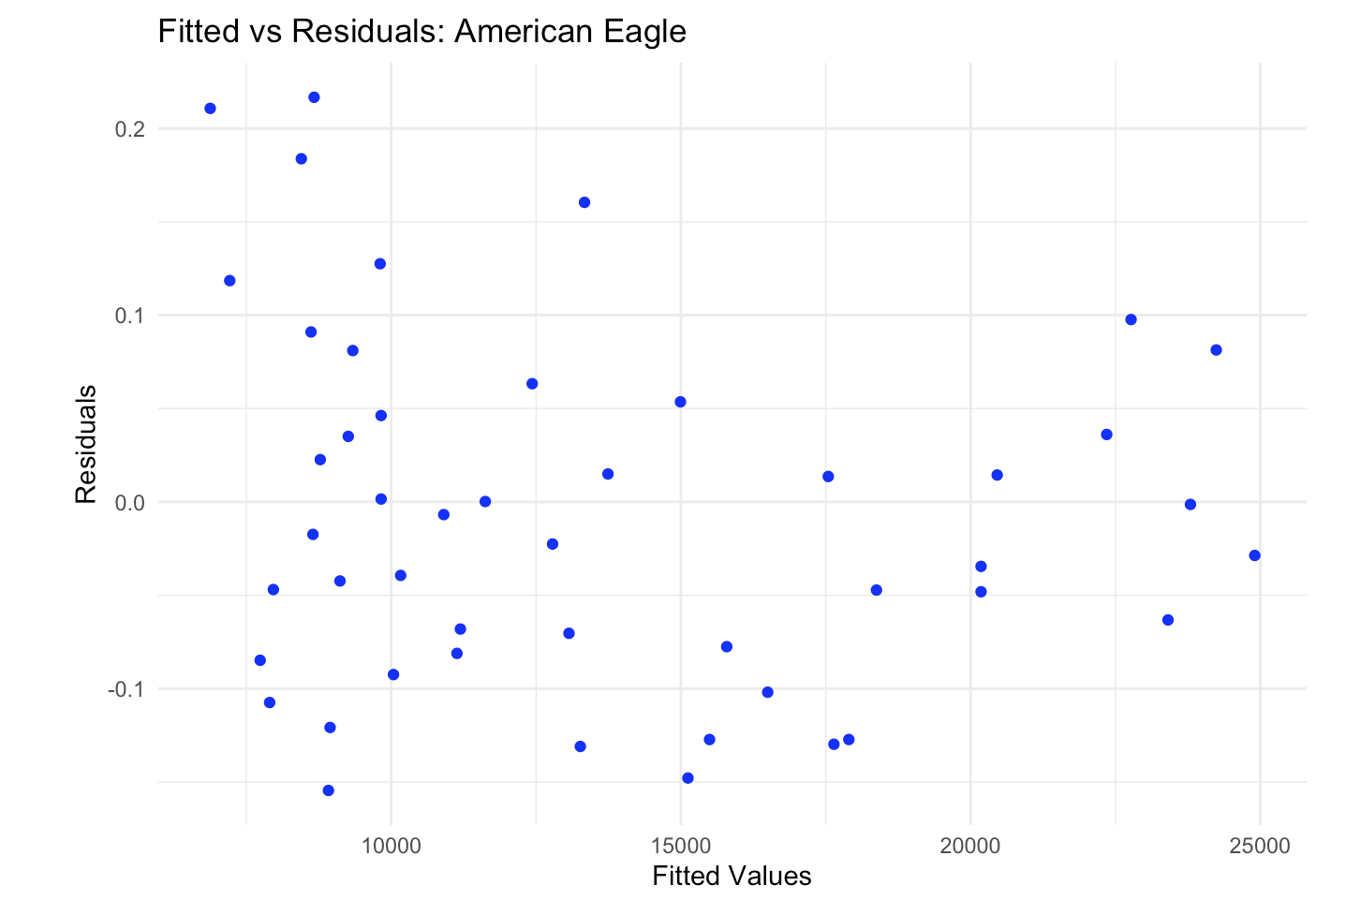
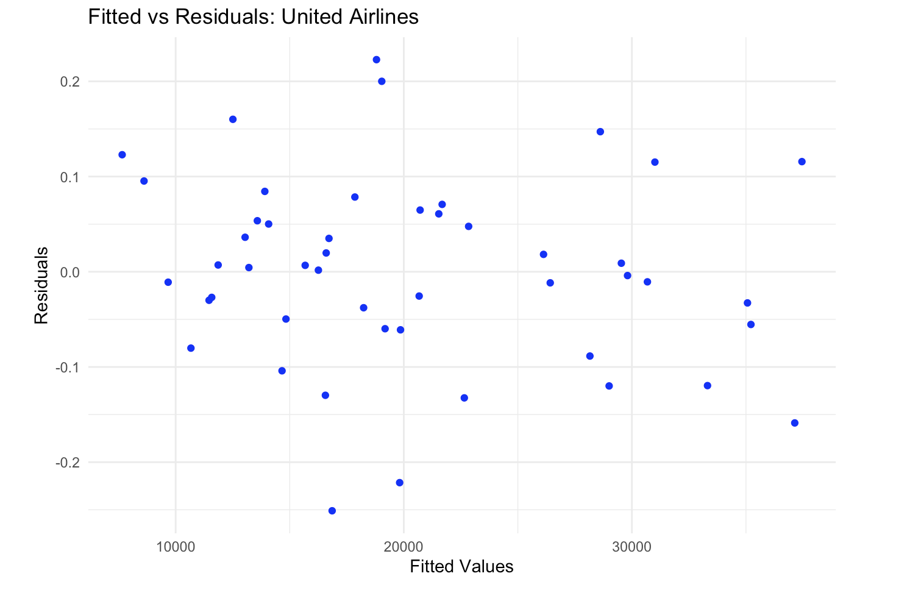
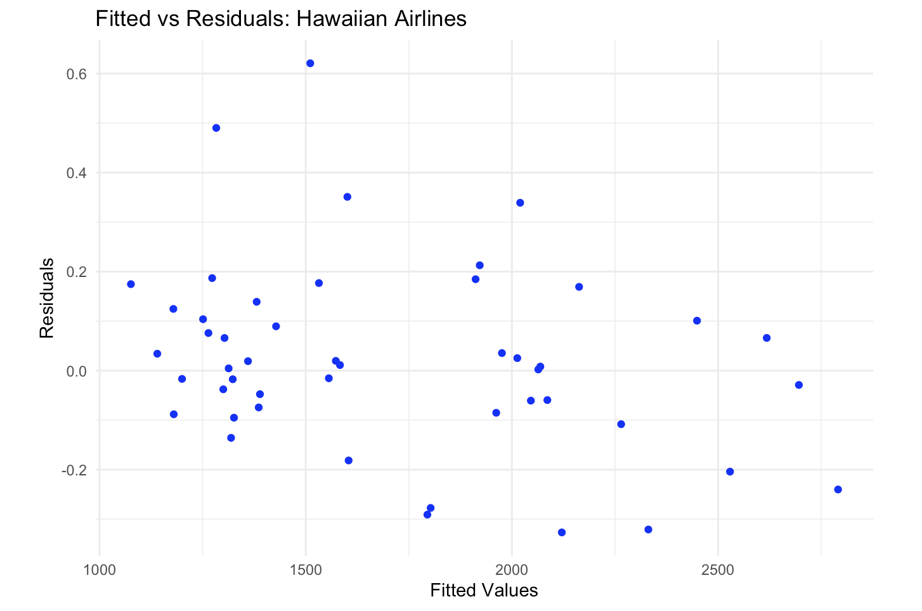

Slide 22
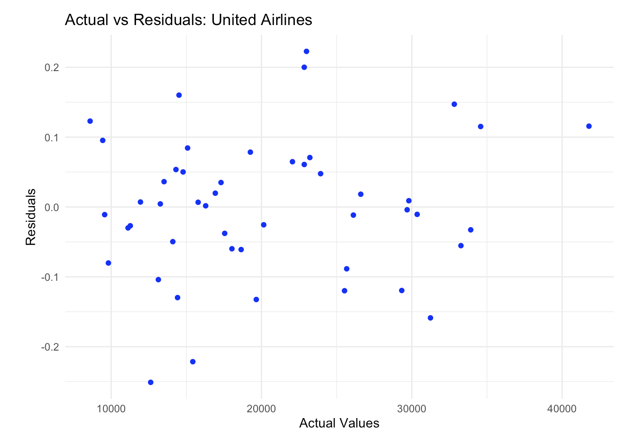
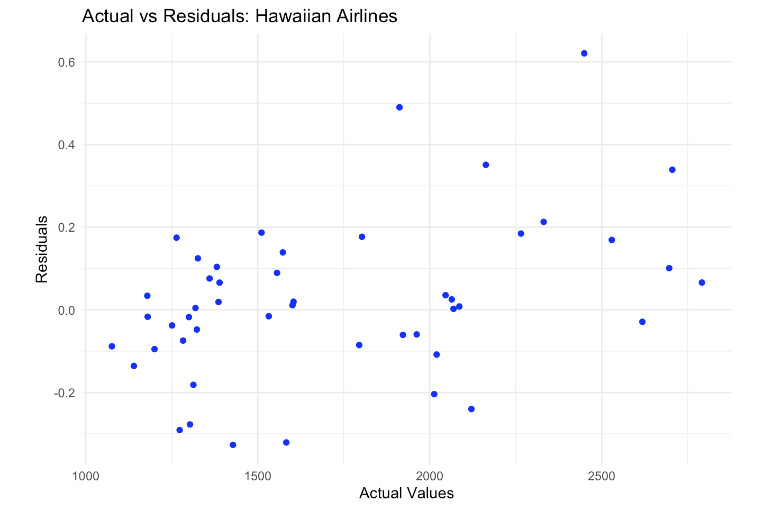
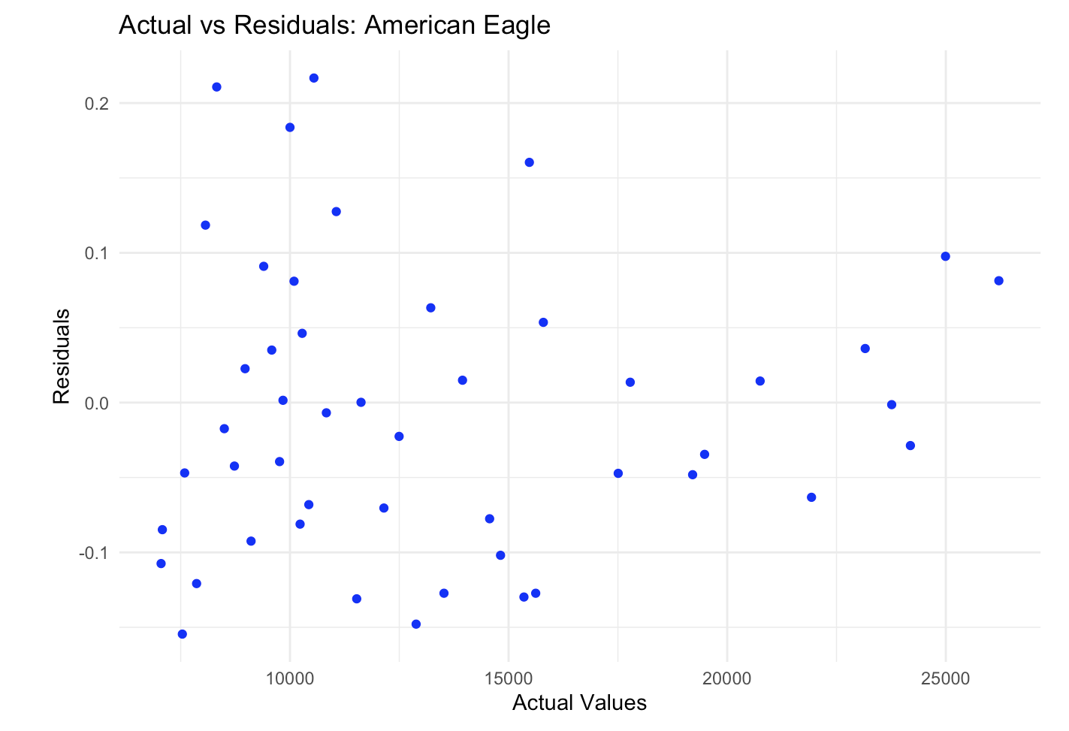

Slide 23
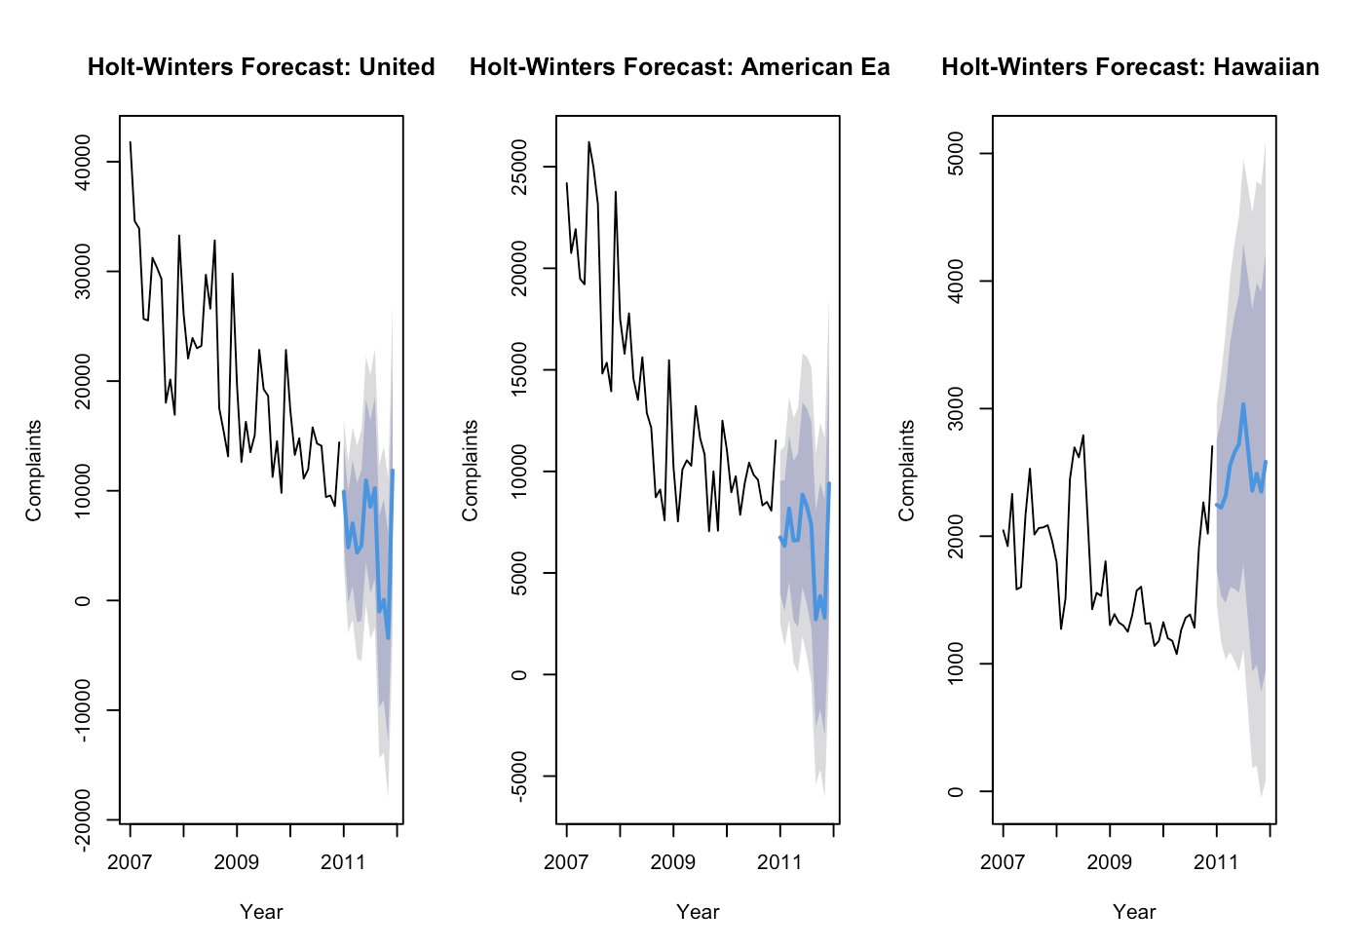
Holt’s-Winter Model

Slide 24
Model Summary
United Airlines
Alpha = 0.621, The model reacts moderately to changes in the level, giving a fair balance to recent and historical data.
Beta = 0.0001, The trend changes very slowly.
Gamma = 0.0001, Seasonal changes are minimal and evolve very slowly.
Focus on high-complaint months to further improve customer satisfaction.
American Eagle
Alpha = 0.5743, the model reacts moderately to level changes.
Beta = 0.0003, The trend changes slightly faster than United
Gamma = 0.0321, Seasonal adjustments are slightly more compared to United Airlines.
Monitor months with seasonal peaks and optimize operations during these periods.
Hawaiian Airlines
Alpha = 0.9226, the model heavily relies on recent data,
Beta = 0.0001, Negligible trend, as complaints remain stable.
Gamma = 0.0001, Seasonal adjustments are minimal
Maintain consistency in operations to keep complaints stable.
Address occasional spikes in complaints.

Slide 25
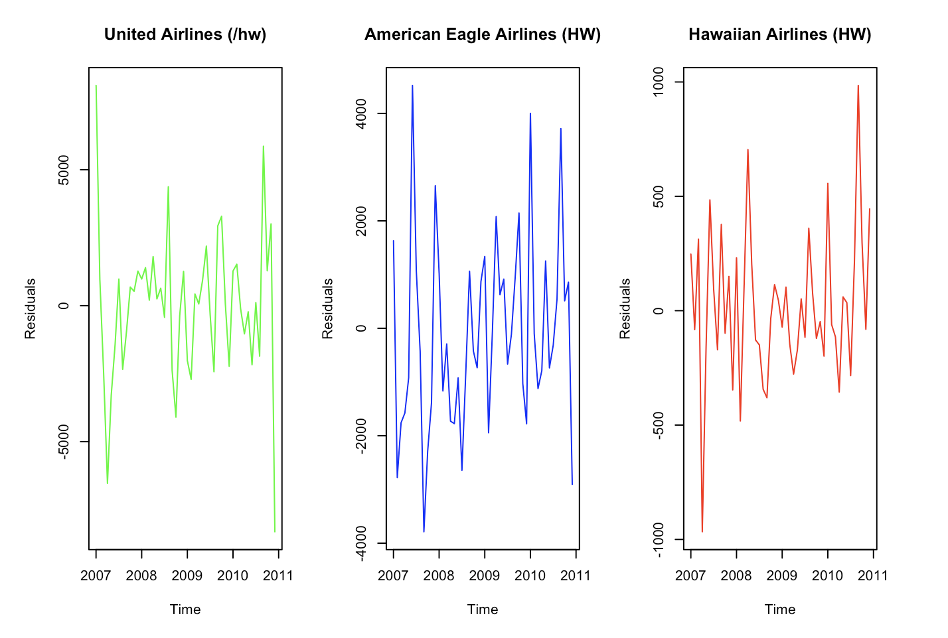
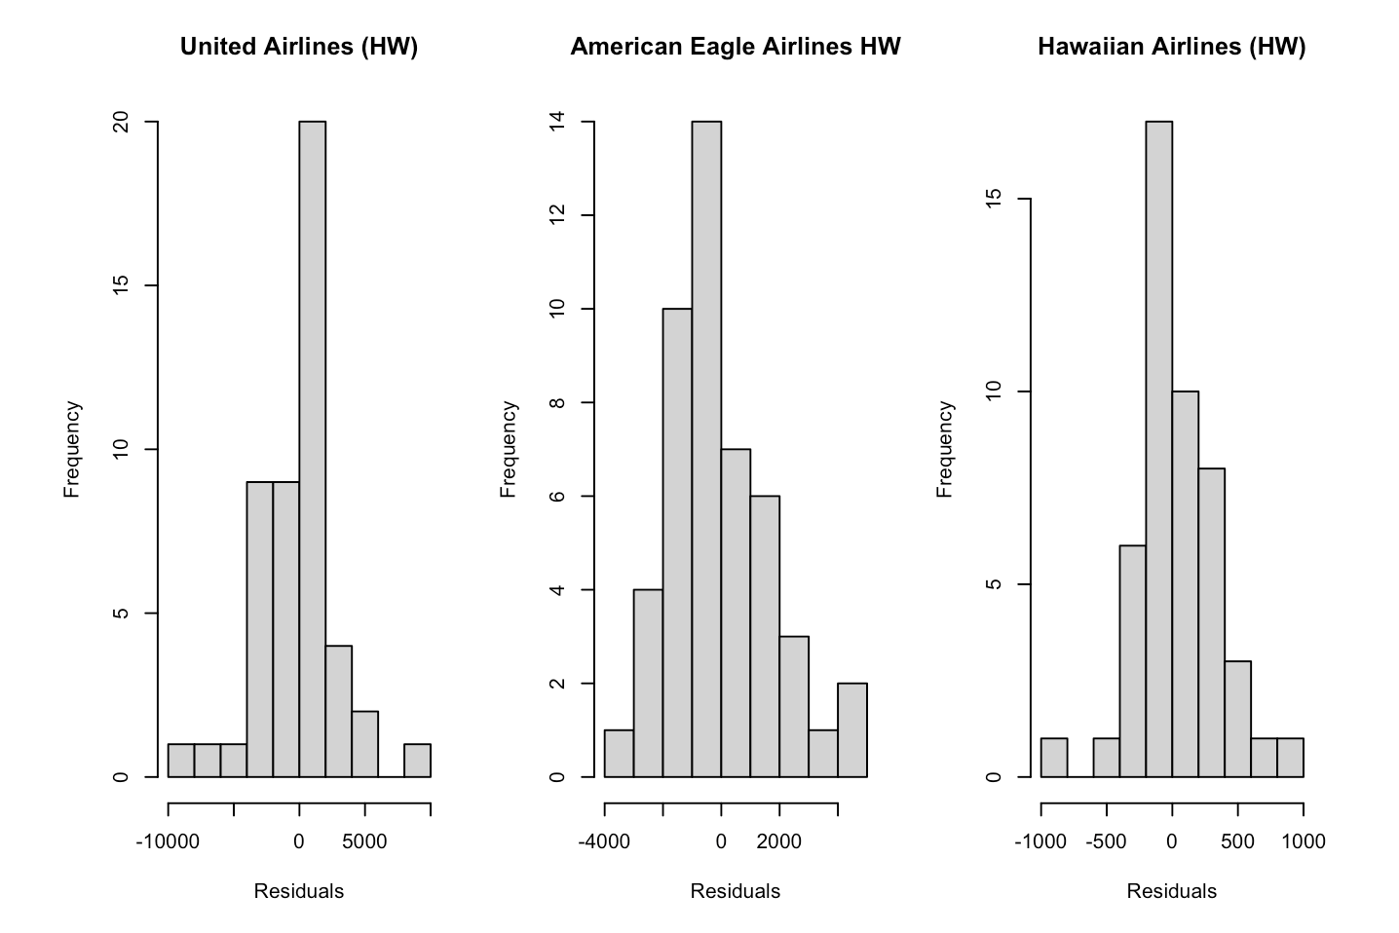
Residual Analysis

Slide 26
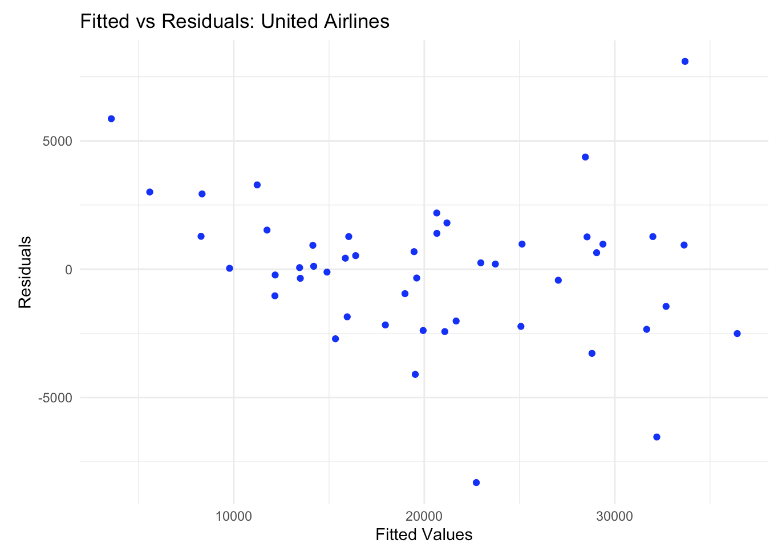
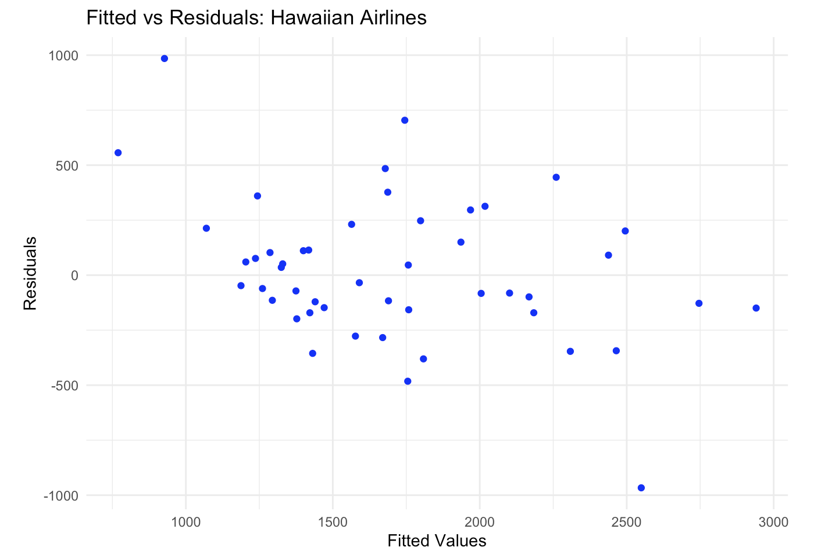
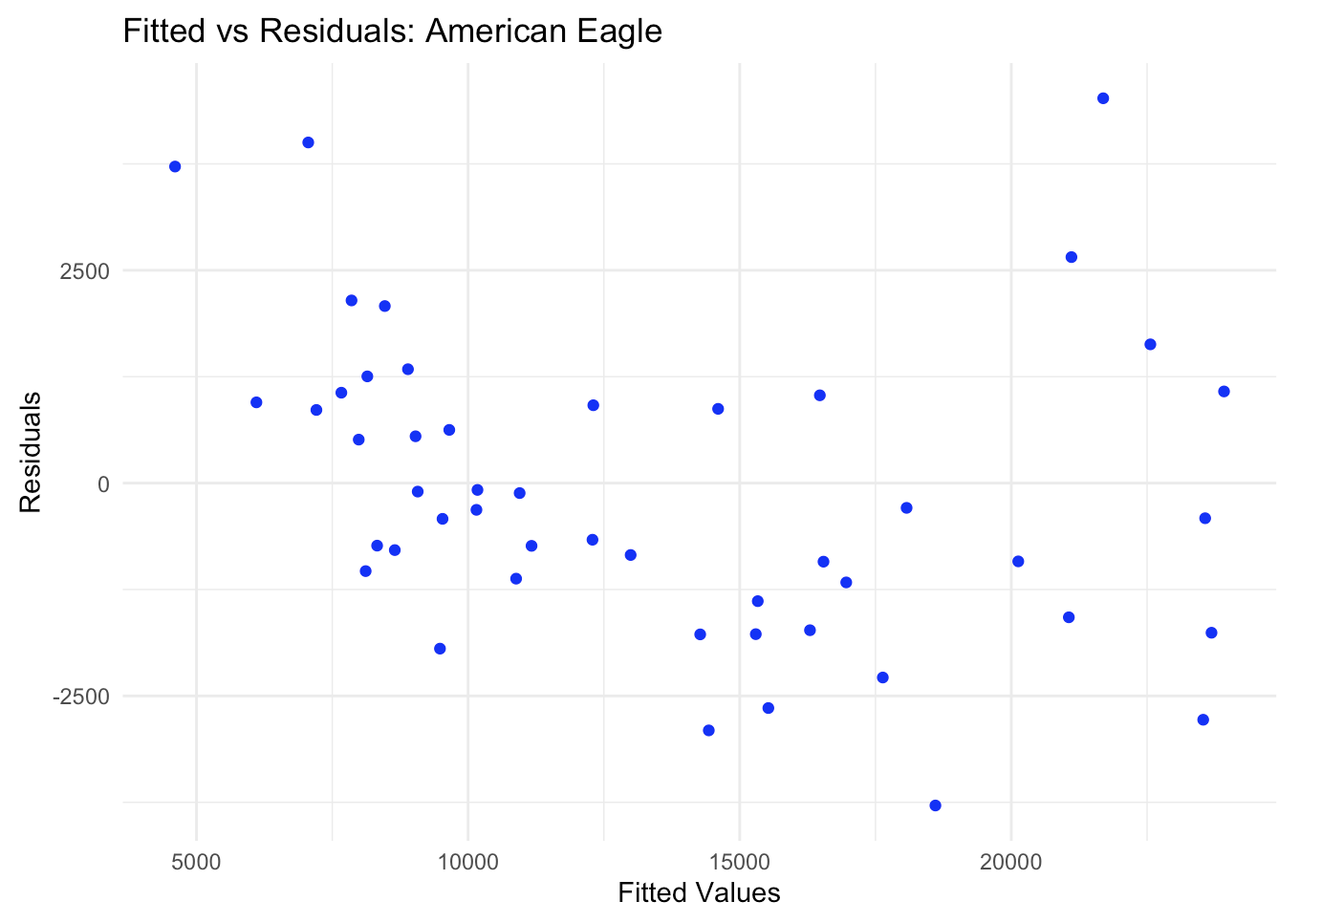

Slide 27
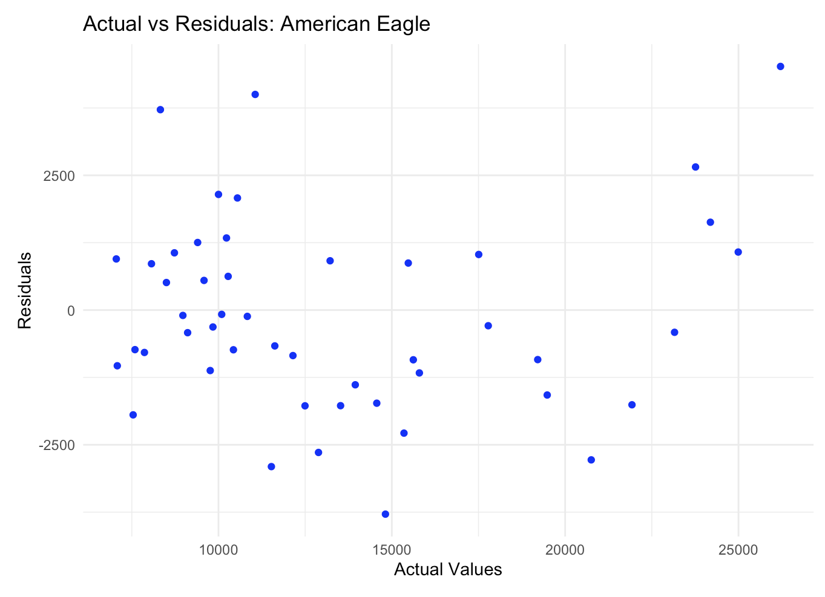
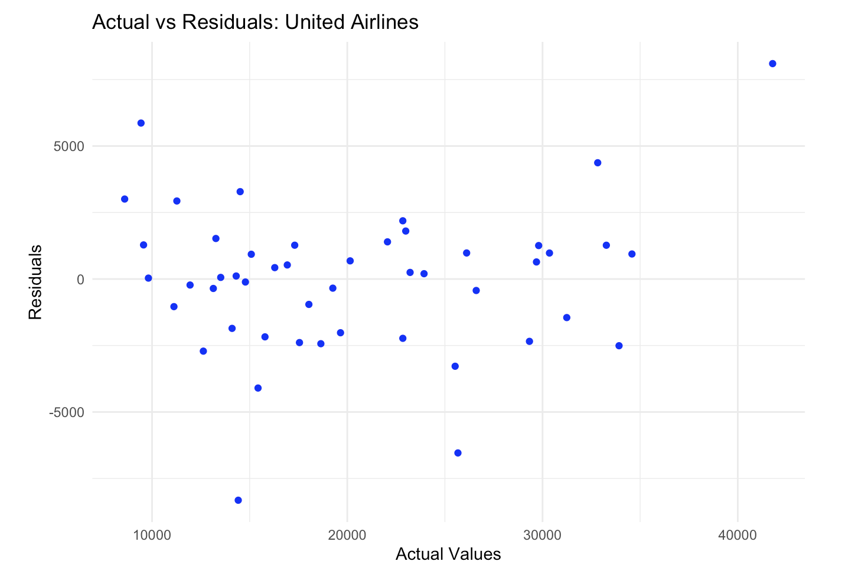
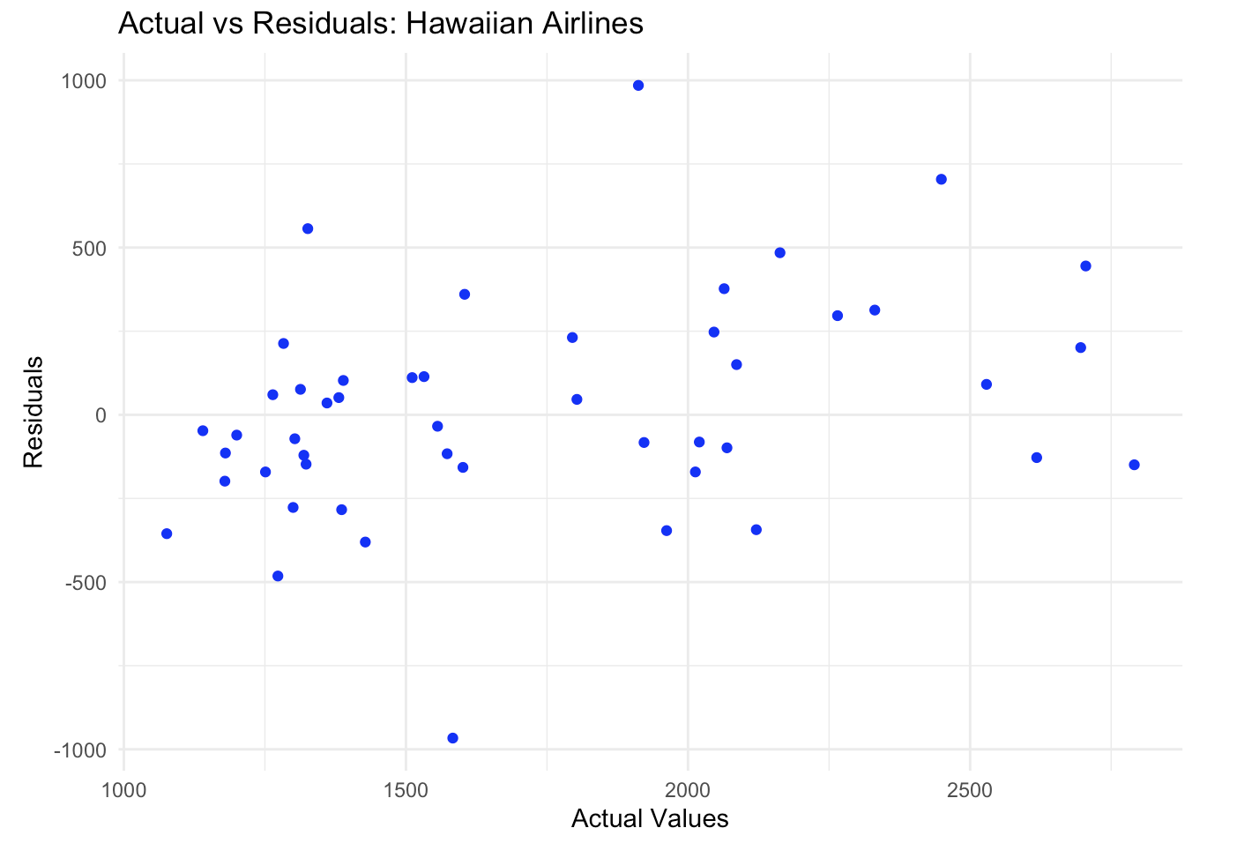

Slide 28
Accuracy Summary
AIRLINE | MODEL | MAPE | RANK
UNITED | NAÏVE | 24.8 | 3
 | AVERAGE | 38.7 | 4
 | ETS | 7.81 | 1
 | HOLT’S WINTER | 11.1 | 2
AMERICAN EAGLE | NAÏVE | 19.5 | 3
 | AVERAGE | 34.7 | 4
 | ETS | 7.77 | 1
 | HOLT’S WINTER | 11.4 | 2
HAWAIIAN | NAÏVE | 13.8 | 2
 | AVERAGE | 25.1 | 4
 | ETS | 13.6 | 1
 | HOLT’S WINTER | 14.4 | 3

Slide 29
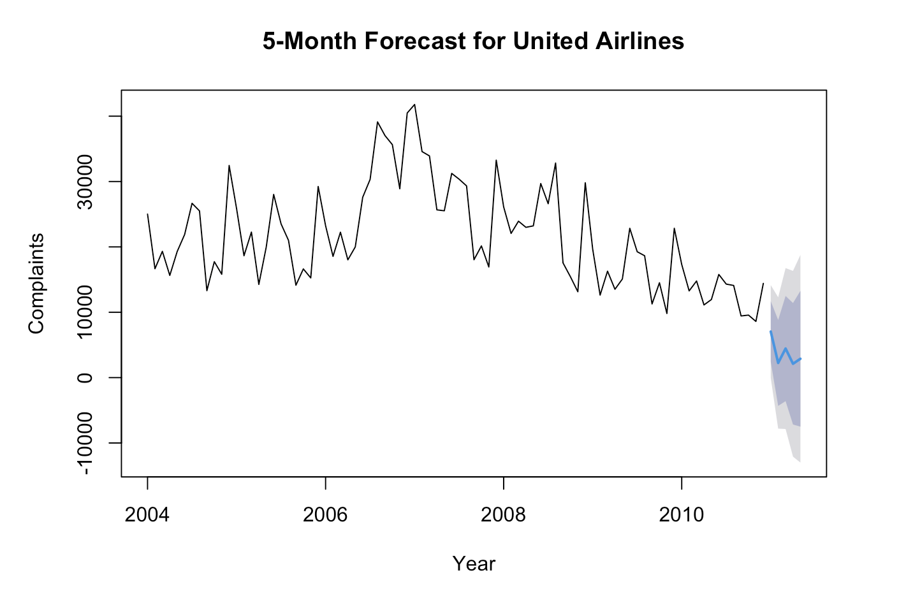
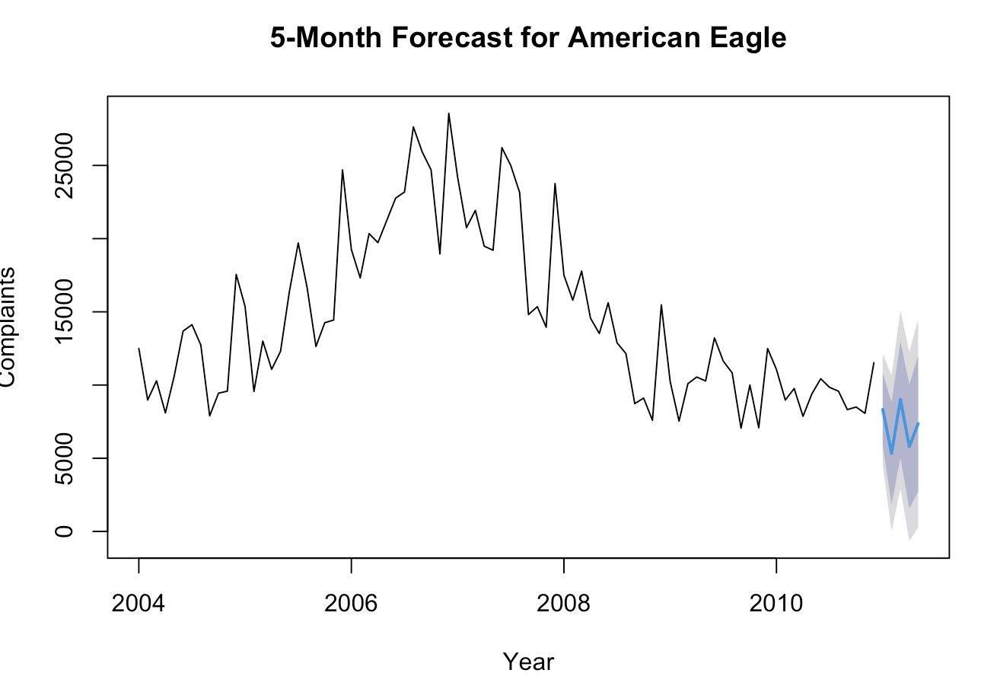
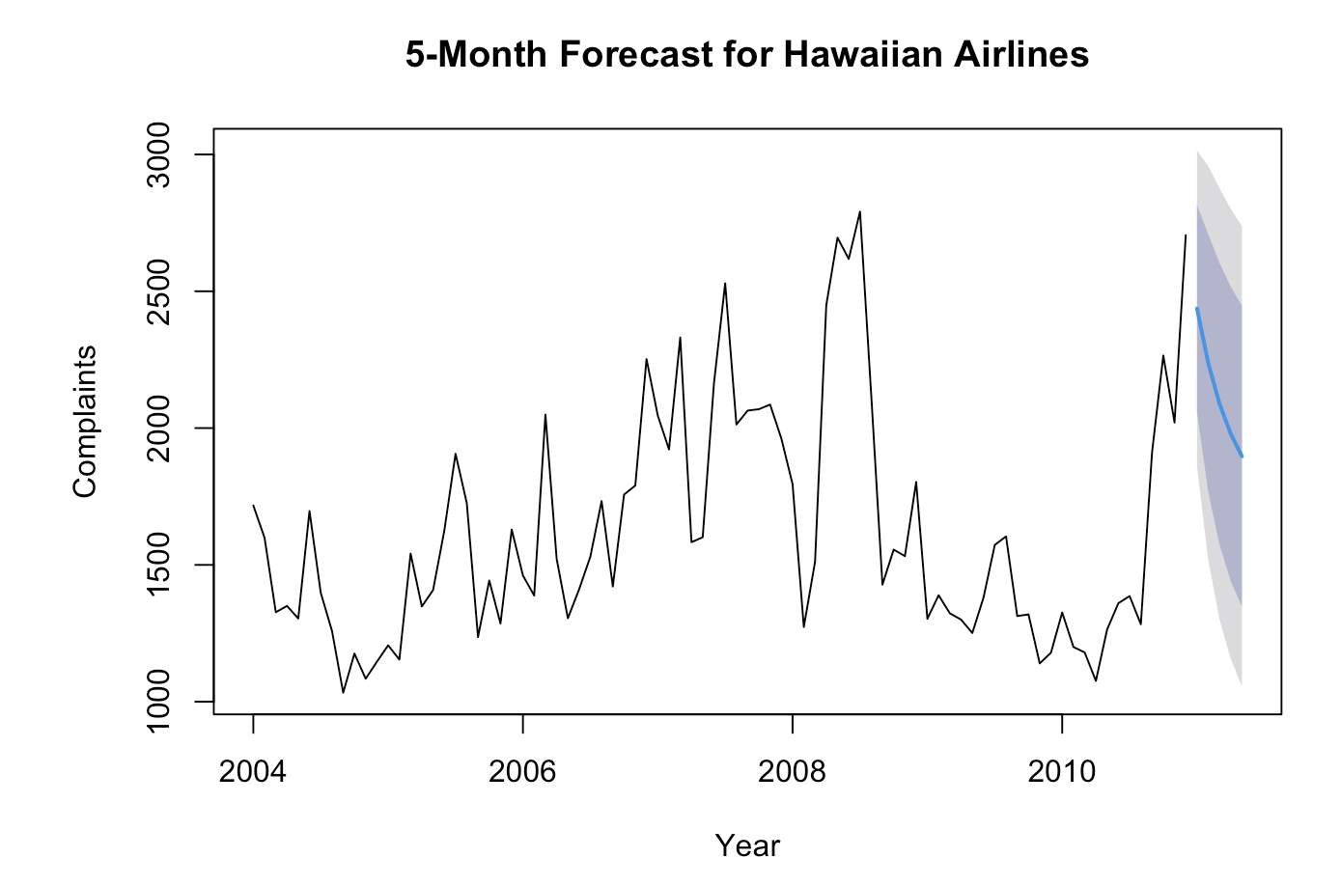
ARIMA Forecasting Analysis
United Airlines
For January 2011, complaints are expected to be around 7,048
The forecast is less reliable and shows high uncertainty.
American Eagle
For the next 5 months, the predicted complaints are more stable, ranging from 5,335 to 9,013 on average.
Hawaiian Airlines
Complaints for the next 5 months are predicted to remain low and stable, around 2,437 in January 2011.

Slide 30
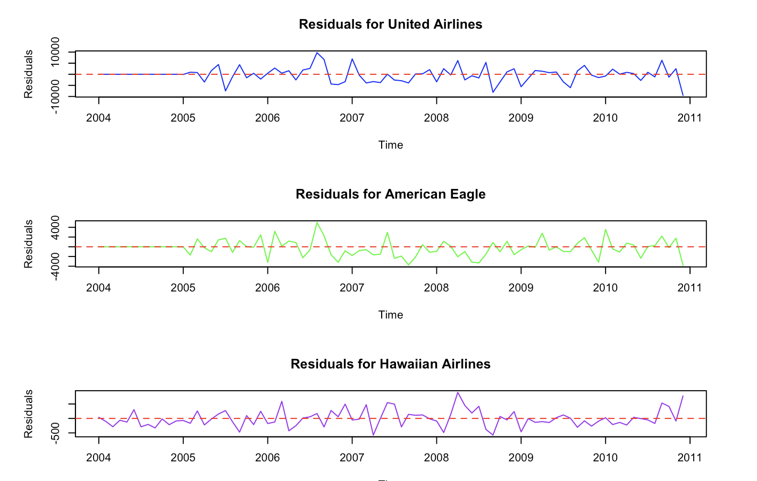
ARIMA Residual Analysis
Residuals are centered around zero.
No significant autocorrelation observed (ACF plots).

Slide 31
Regression Analysis
Linear regression model for predicting baggage complaints:
Baggage = -830.02 + 0.4779 * Scheduled
Key insights:
- R² = 66.8%, indicating good explanatory power.
- F-statistic = 503.5, p-value < 0.001 (model is significant).

Slide 32
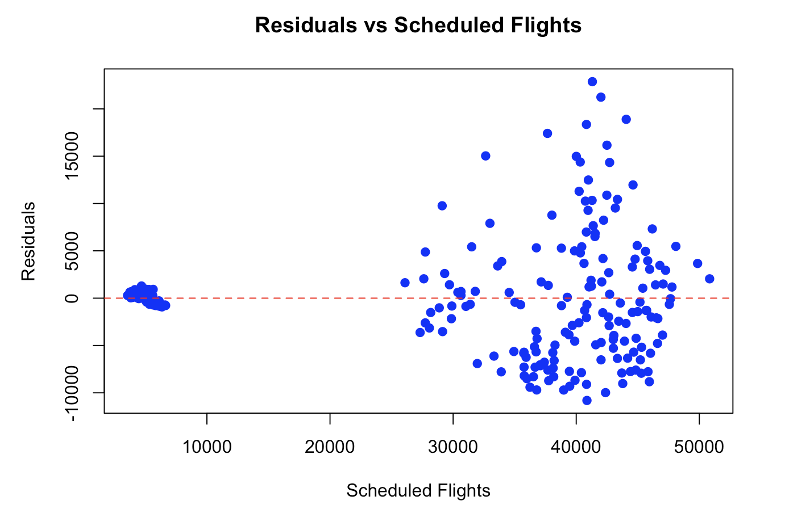
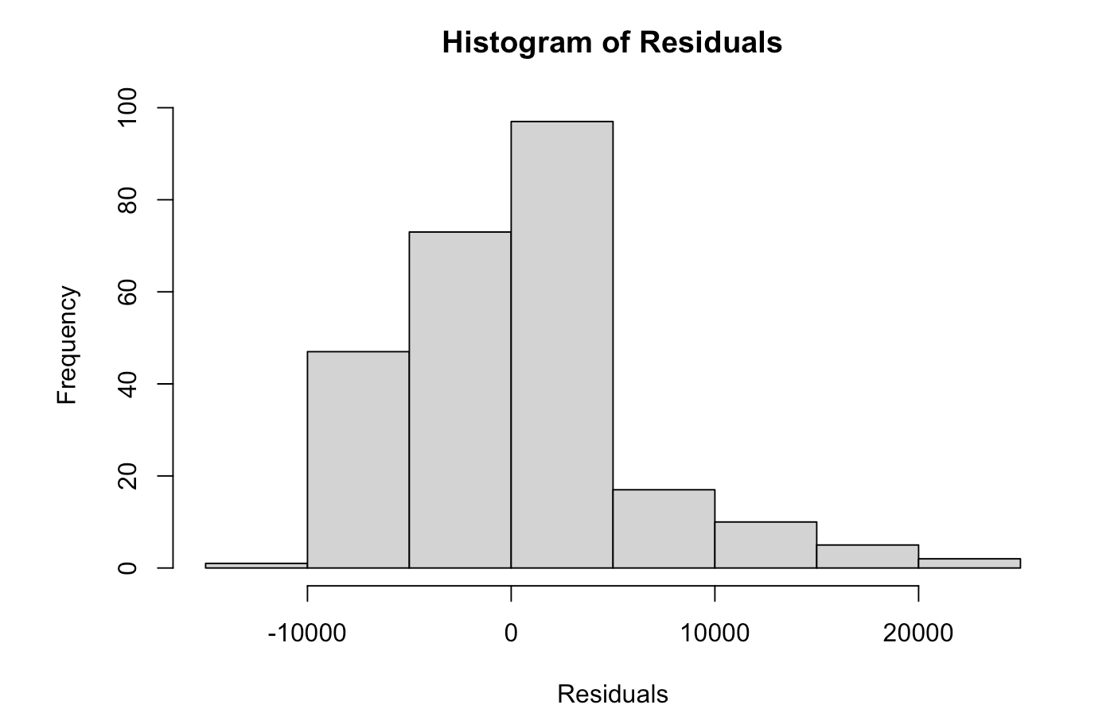
RESIDUAL ANALYSIS
Residuals are scattered around zero (no clear pattern).
Slight skewness observed in the histogram.
The linear model captures the relationship effectively.

Slide 33
Decision Based on Analysis
United Airlines:
Key Focus: Enhance baggage handling during peak months like December and July to mitigate seasonal spikes.
Action Plan: Introduce scalable measures such as increased staff and automated baggage systems during high-demand periods.
American Eagle:
Key Focus: Sustain ongoing improvements and address occasional spikes during summer months.
Action Plan: Optimize resource allocation and monitor seasonal complaint trends for proactive measures.
Hawaiian Airlines:
Key Focus: Maintain the current high standards of performance.
Action Plan: Conduct regular audits and minor optimizations to ensure consistency.

Slide 34
Recommendations to Improve Forecasts
Regularly update forecasts with new data.
1
Prepare for high, medium, and low complaint scenarios.
2
Integrate customer feedback for qualitative insights.
3

Slide 35
THANK YOU

